Slide 1

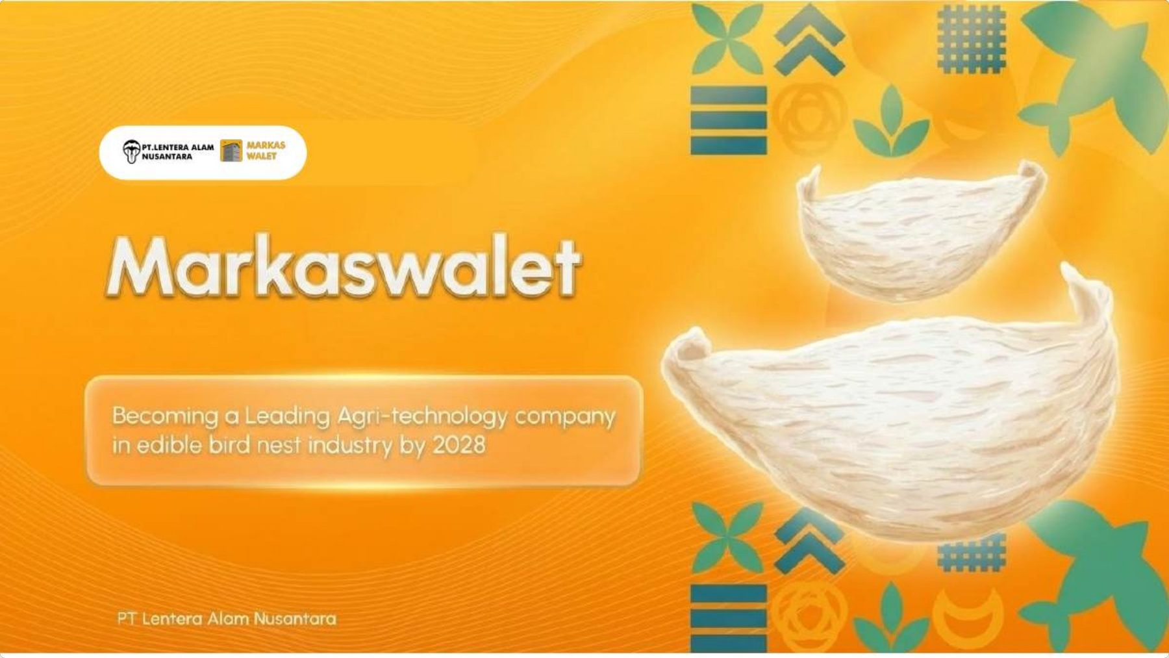



Slide 2
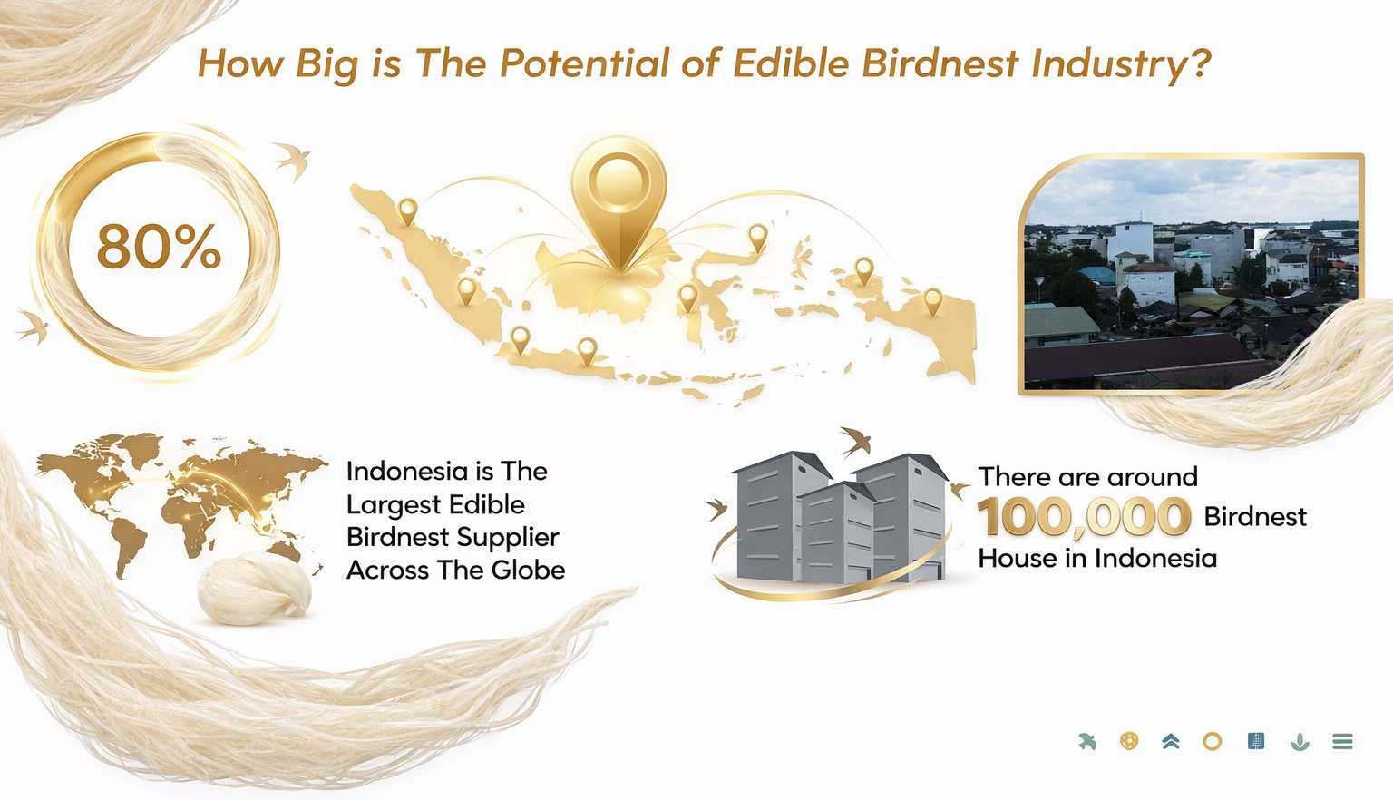




Slide 3










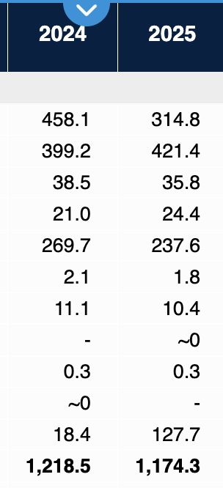
Destination
2020
2021
2022
2023
2024
2025
MARKET OPPORTUNITY
Hongkong
897.2
989.9
734.4
630.9
458.1
314.8
How Is The Export Trend of Edible Birdnest from Indonesia?
China
263.5
228.8
290.0
401.7
399.2
421.4
Singapore
68.8
80.0
45.2
36.0
38.5
35.8
United States
20.4
66.2
31.0
18.9
21.0
24.4
Vietnam
27.2
71.3
236.3
213.2
269.7
237.6
Canada
1.8
2.3
2.4
2.0
2.1
1.8
Taipei
12.9
20.6
9.2
9.1
11.1
10.4
Thailand
2.4
1.8
0.5
-
-
~0
Japan
0.3
0.1
0.1
0.3
0.3
0.3
Kambodia
-
-
0~
-
0~
-
Others
17.9
44.4
66.7
22.9
18.4
127.7
Amount (kg)
1,312.5
1,505.5
1,415.9
1,335.0
1,218.5
1,174.3

Slide 4
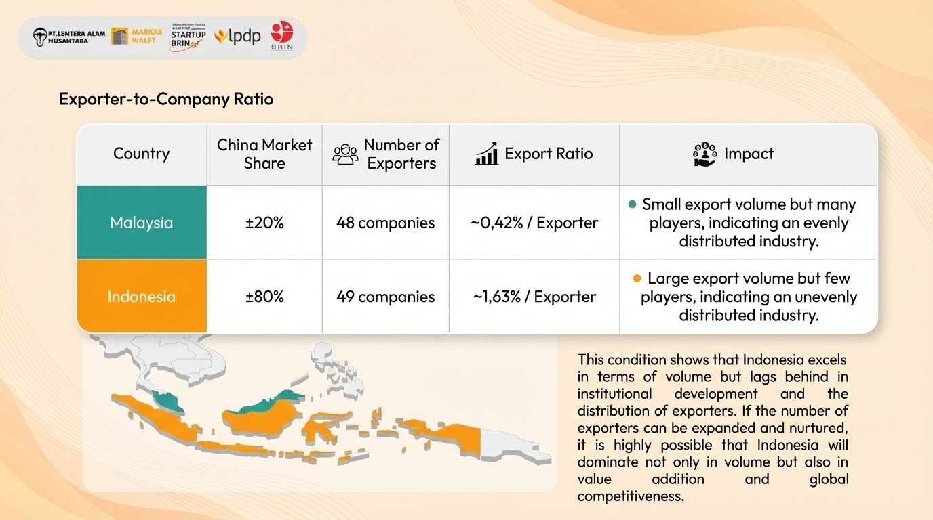

Slide 5
Market Opportunity
Target Market in Downstream Manufacture and Export
TAM
Rp92 T
Total Addressable Market
TAM
Rp92 T
SAM
3.000 Ton (pasar SBW global) × Rp30,8 jt/Kg
Rp9,2 T
SOM
Rp800 M
SAM
Serviceable Available Market
Rp9,2 T
300 Ton — export-grade China + SEA via jalur terdaftar (±10% TAM)
Service Obtainable Market
Rp800 M
SOM B
Kapasitas 35 ton/th × 75% utilisasi ≈ 26 ton (9% SAM)
TAM / SAM / SOM = total, serviceable, and realistically obtainable market size.

Slide 6






Export Core Issues in the Industry
Problem 1 : Birdnest Supply
Problem 2 : Traceability
Problem 3 : Manufacture
1800 TON
Not Registered Yet
100,000 Birdnest House
Not Registered Yet
Birdnest raw quality is hardly to maintain because of supply fragmentation
Procurement team is difficult to control due to widespreadness of supplier location
Low technology adoption in sourcing process
1800 Tons of more than 18.000 productive swallow's house have not registered
Limited skilled labor available for feather-removal in nest cleaning
High shrinkage rates persist during the washing/cleaning process.
Low technology adoption in manufacturing; operations remain predominantly traditional/manual.
400 TON
Registered

Slide 7

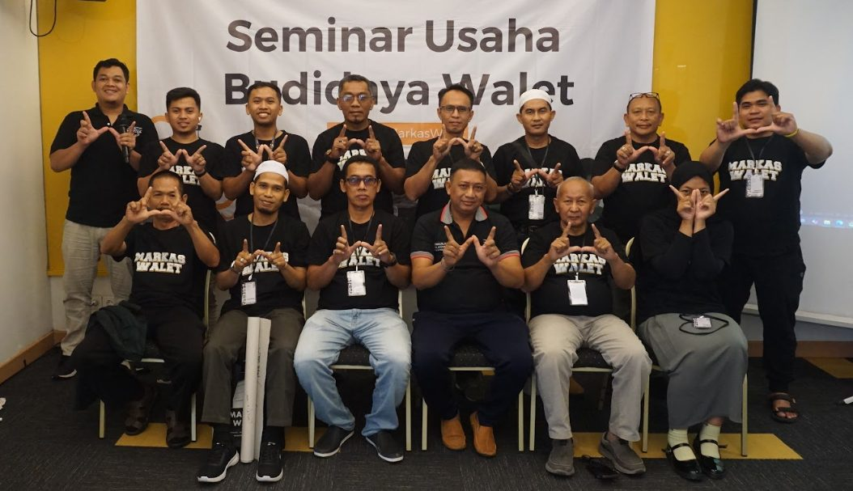
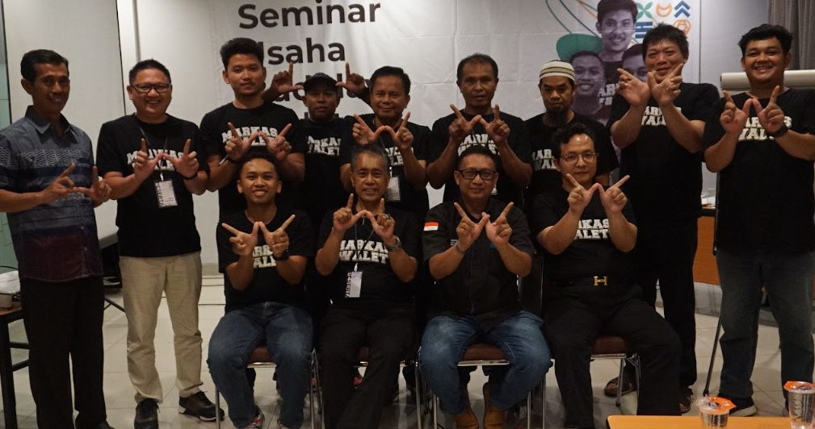
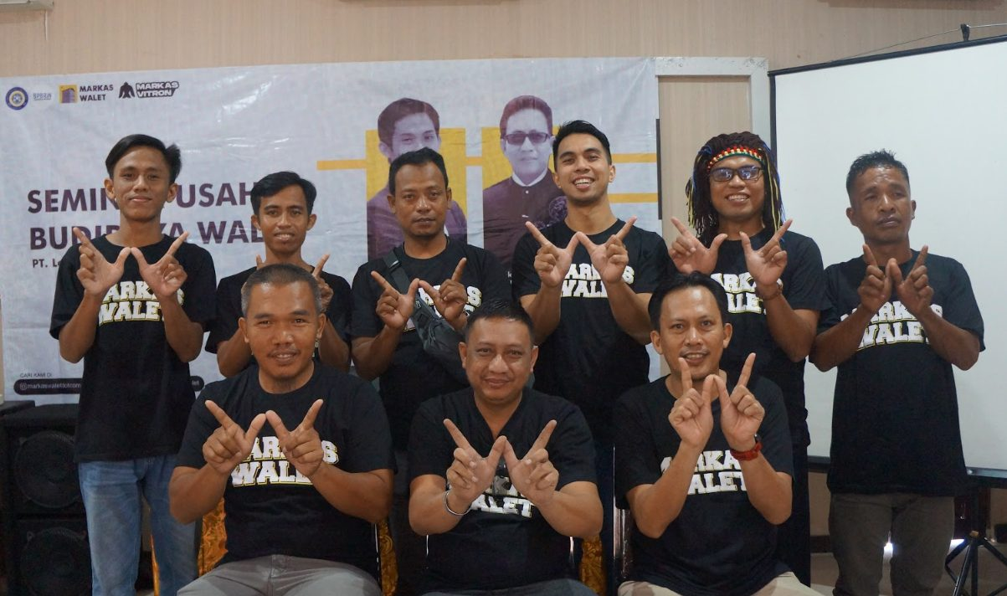
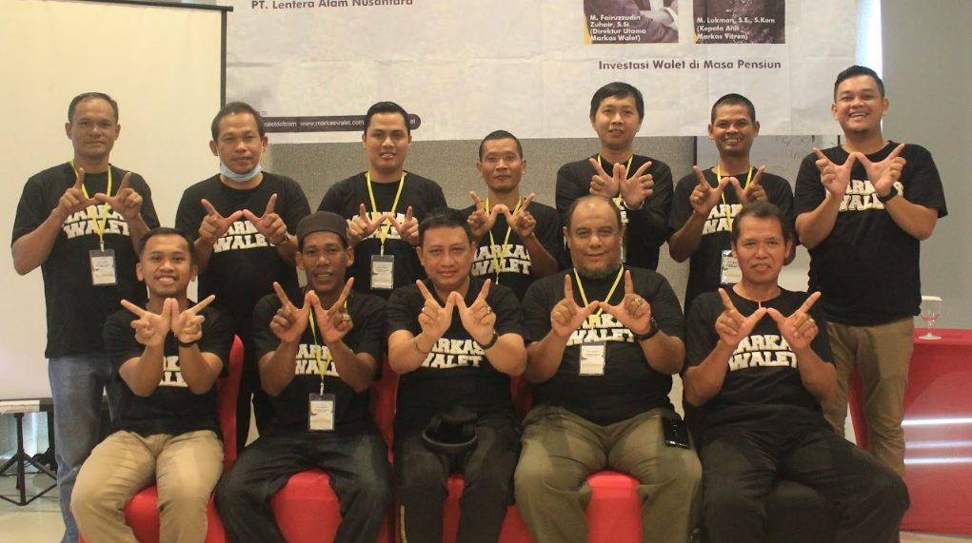
Solution for Supply: A National Footprint of Networking Coverage
A nationwide farmer acquisition strategy to solve fragmented birdnest supply.
Active Since: Alumni Seminar Base: Coverage:
2021 250+ Registered Farmers Sumatra, Kalimantan, Sulawesi, Java/Lombok
Pekanbaru
Balikpapan
Pontianak
Samarinda
Padang
Jambi
Palangkaraya
Palu
Palembang
Banjarmasin
Makassar
Lombok

Slide 8

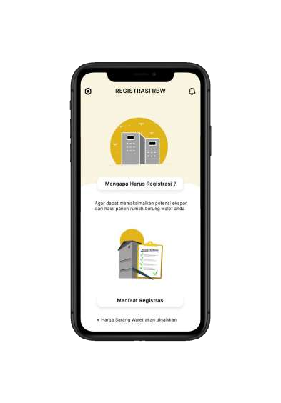
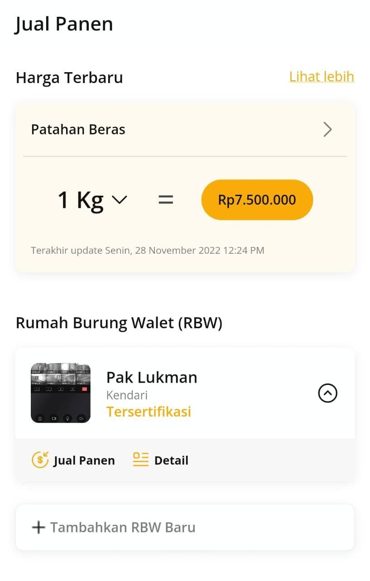

Our Innovation and Solution
Solution for Traceability
IKH registration for swiftlet houses via the Markaswalet app
Obtain government certifications
Sell the harvest to Markaswalet
Receive standard facilities at no cost (FREE)

Slide 9
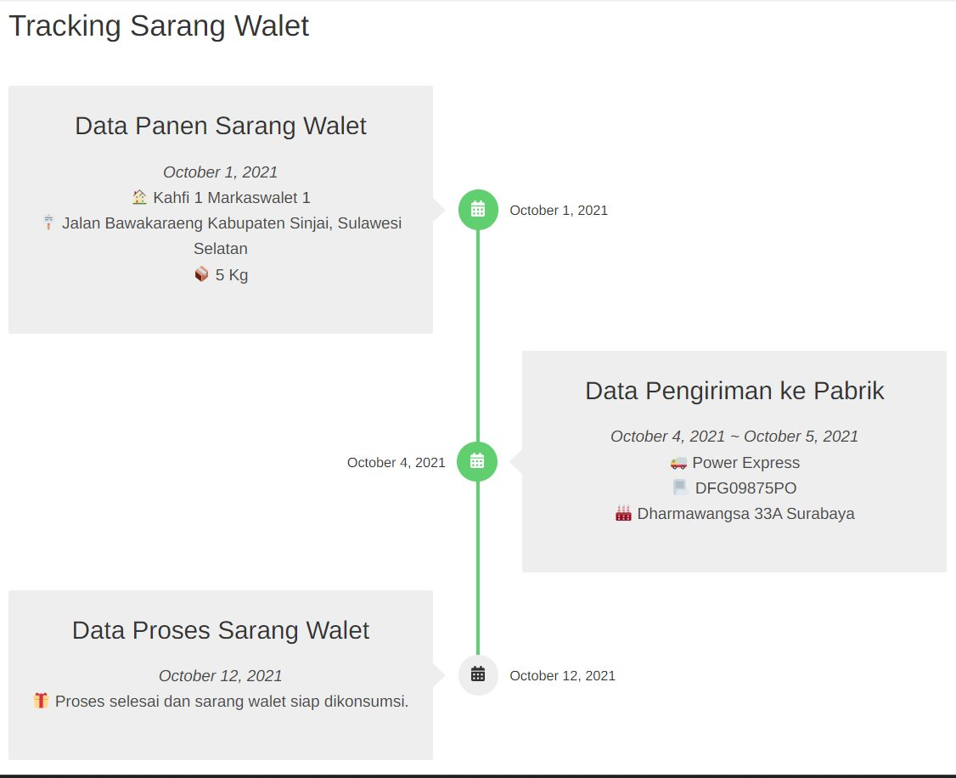
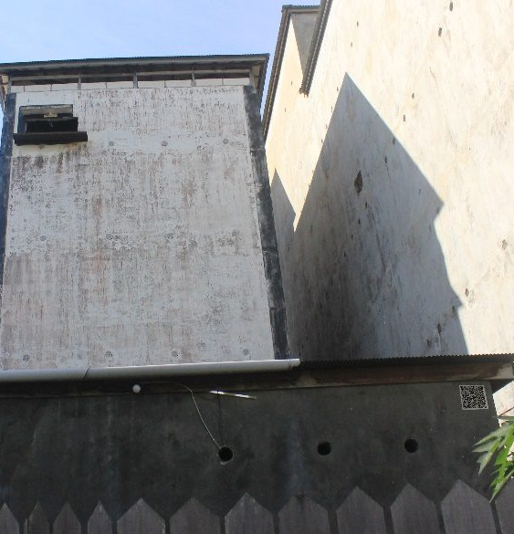
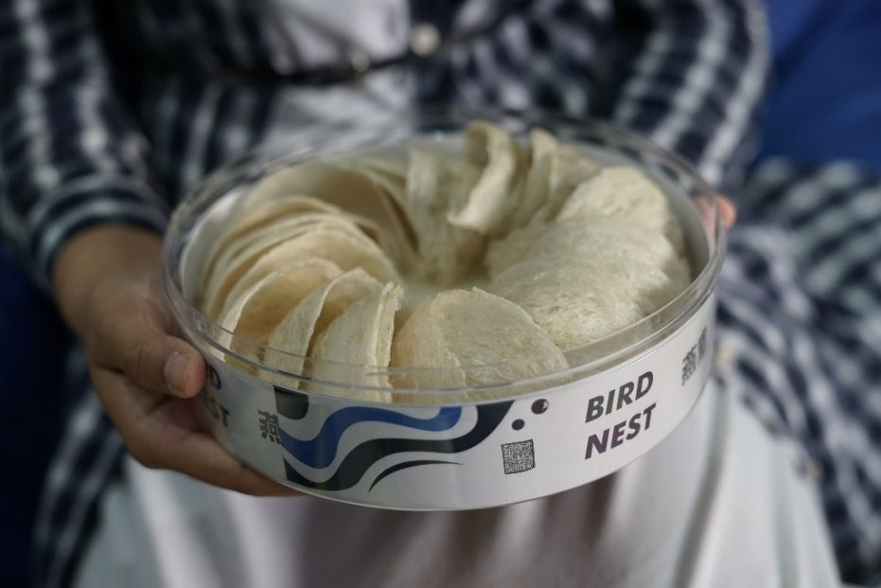

Our Innovation and Solution
Solution for Traceability
Birdnest Harvest Tracking
Traceability Technology with barcode system

Slide 10
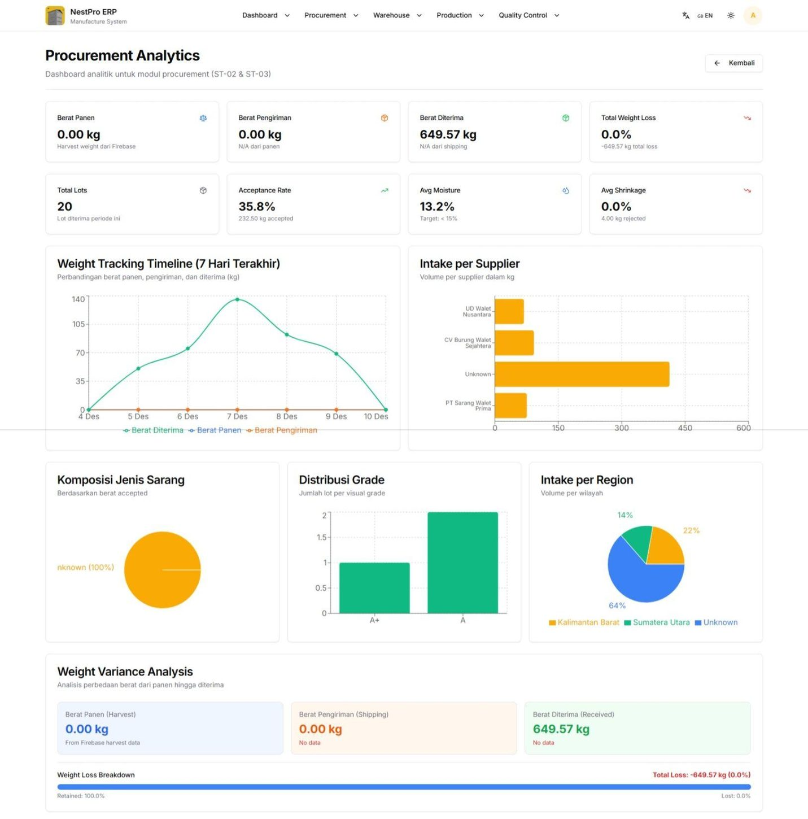
Our Innovation and Solution
Solution for Manufacture
NestPro ERP for Exporters
1. Integrated Dashboard
A centralized dashboard, real-time visibility, 16-stage manufacturing flows from soaking to final packaging.
2. Real-Time Monitoring
Tracks shrinkage, productivity, and quality at the batch level in real time
3. Compliance by Design
Workflows and documentation are built-in to align with ISO, HACCP, and GACC standards

Slide 11
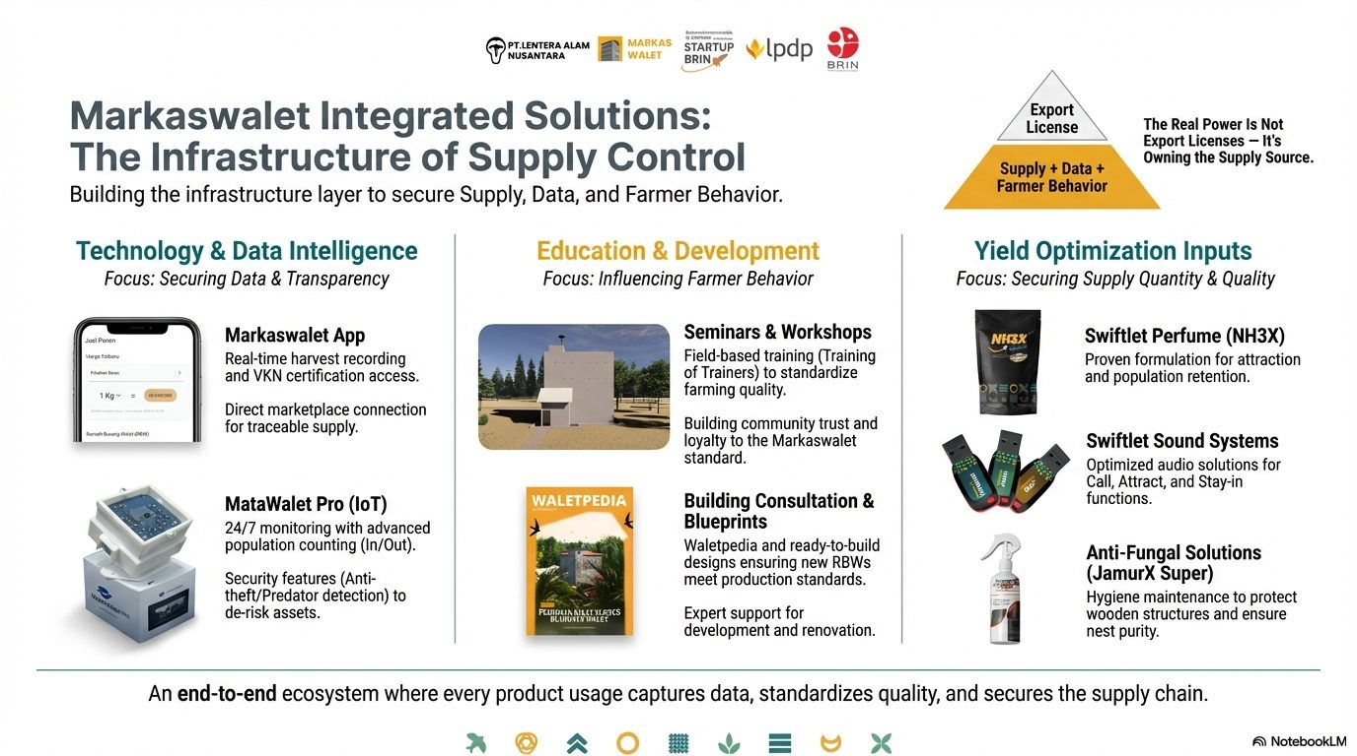

Slide 12
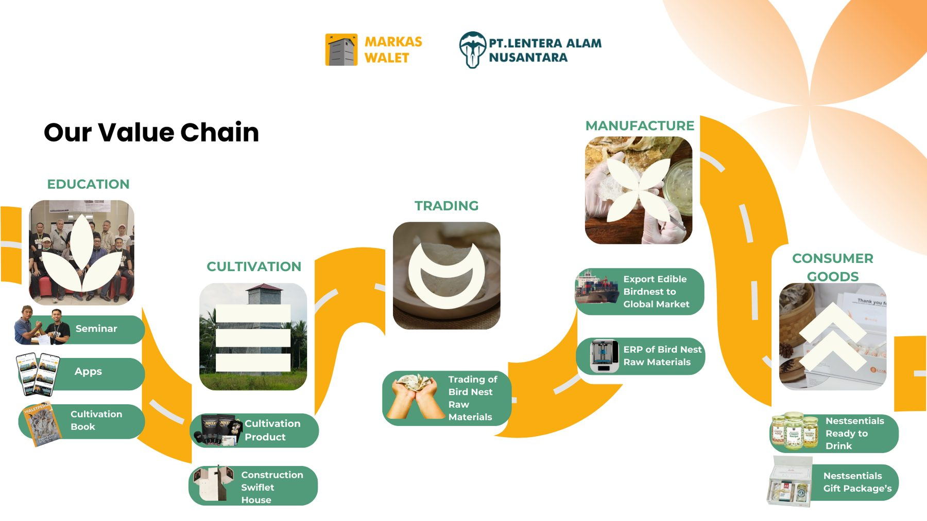

Slide 13




Our Revenue Stream
Agritech Products & Services
Government & Institutional Projects
The Retention Engine
Consumables (Birdnest perfume, Anti-fungal agents), Bird feed, and IoT cameras. Creates operational dependency for farmers.
Legitimacy & Moat
Farmer education, RBW registration, and Policy programs. Adds barriers to entry.
Raw Material Trading
SaaS / ERP Subscription
The Core Engine
Asset-backed liquidity.
Volume-driven cash flow generator that powers the entire ecosystem.
High Margin Recurring Revenue
NestPro ERP for exporters.
Provides China-ready traceability & compliance systems. High switching costs.

Slide 14

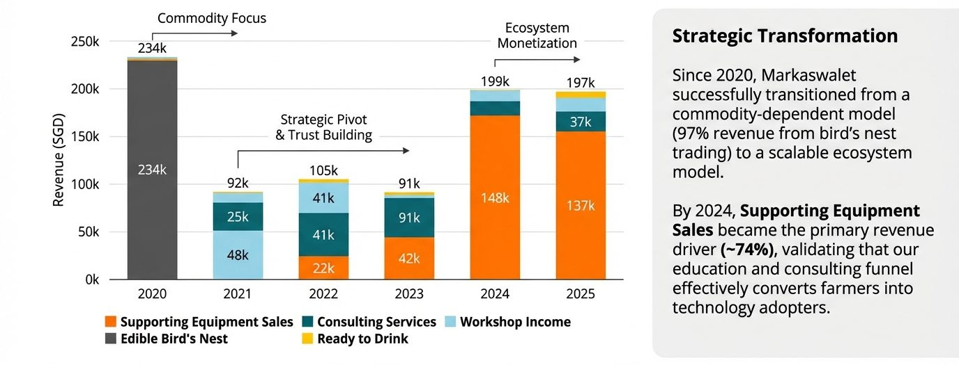
Revenue Stream Evolution (2020-2025)
Pivot from Commodity Trading to High Margin Equipment Sales

Slide 15
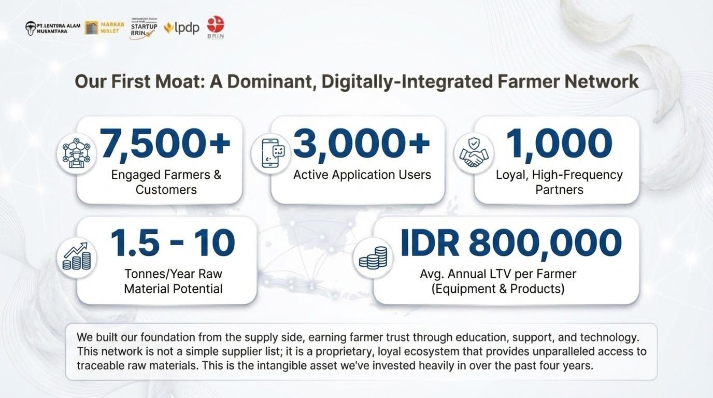

Slide 16






Business Model Innovation: Trading Raw Materials
Core Activity:
Markaswalet's visible business is trading raw edible bird's nest from farmers to exporters.
Trading RAW Material
Top Layer
Visible Activity
The Reality:
We are not a trader competing on price. We are a platform that monetizes the ecosystem around the trade.
Bottom Layer
The Engine & Moat
High Switching Costs (Hardware/Software lock-in)
Recurring Revenue (SaaS & Consumables)
Data & Compliance Moats (Traceability)
Traditional Trader = Arbitrage & Price War
Markaswalet = Ecosystem Lock-in & Recurring Revenue
Compliance & Traceability
Digital
Infrastructure
Agritech Inputs
Switching costs = how hard it is for a farmer or exporter to leave the platform once their tools, data, and supplies live on it.

Slide 17
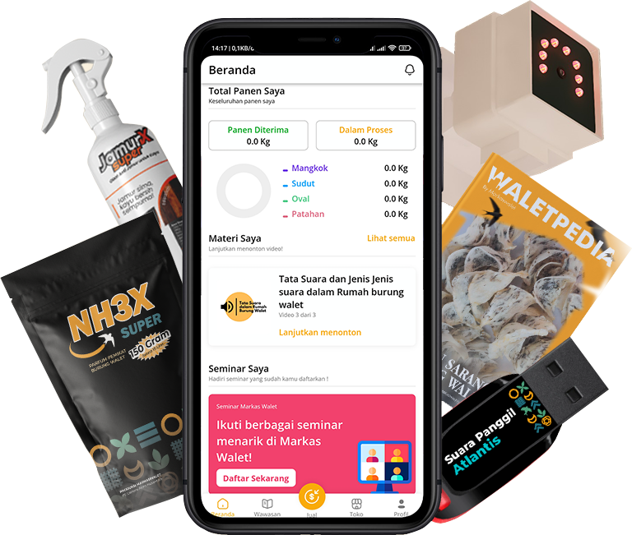



Business Model Innovation
Supply Side Economics - Why Paying a Premium Works
We pay farmers +10% above market.
Farmer buys inputs: Perfume, Sound, Feed, IoT Subscription.
Efficiency Gain + Loyalty.
The Logic:
We 'lose' 50 SGD on the buy-side price war to win the volume, but we 'gain' 100 SGD on the ecosystem sales.
Results:
We monetize the entire wallet of the farmer, not just the commodity transaction.
Net Value
Capture
Trading Premium
Ecosystem
Cross-Sell
-50 SGD Cost
(Market Price 500 vs. Our Price 550)
+100 SGD Profit per farmer
+50 SGD
Net Gain

Slide 18

Business Model Innovation
Demand Side Economics: Scaling via Compliance-as-a-Service
The Math (Per Exporter Client)
Trading: Market selling price 600 SGD/kg with ~50 SGD margin.
SaaS Layer: NestPro ERP Subscription ≈ 10,000 SGD/year.
Scale Effect: For a client buying 1,000 kg/year, the ERP adds an effective ~10 SGD/kg of pure margin without handling extra goods.
NestPro ERP Revenue
(-10 SGD/kg effective)
Pure Margin from SaaS (Recurring)
Trading Margin (~50 SGD/kg)
Trading Margin (~50 SGD/kg)
Key Insights:
We monetize the process of trading. This scales without needing to own massive factories first.
Traditional Trader
Markaswalet Model
SaaS = software subscription. Compliance-as-a-service: exporters subscribe to NestPro ERP to stay audit-ready and export-eligible.

Slide 19

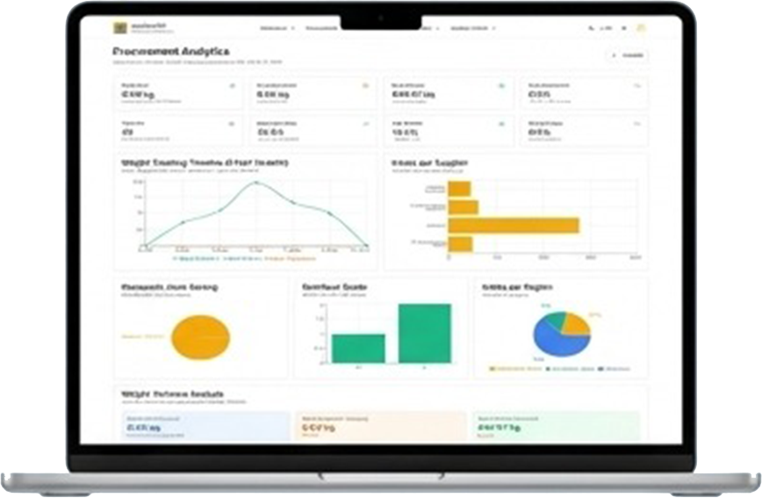







Business Model Innovation: A Two-Sided Platform
The Engine: A Two-Sided Platform Creating an Ecosystem Lock-In
Tools: Markaswalet App for harvest tracking, RBW (Swallow Bird House) registration, and quality management.
Value to Farmers: Fairer, transparent pricing; clear quality standards
The Lock-in: High switching costs are created through dependency on our Agritech tools (e.g., specific perfumes, anti-fungal agents, loT cameras) and the value of their historical harvest data stored on our platform.
We execute our strategy through a proprietary digital platform that creates a virtuous cycle, securing both farmers (supply) and exporters (demand) while generating unparalleled data.
Tools: NestPro ERP for comprehensive manufacturing oversight
Value to Exporters: Provides audit-ready documentation, dramatically reducing the risk of shipment rejection.
The Lock-in: Exporters are not just buying raw materials; they are subscribing to a system that is critical for their compliance, quality control, and access to a certified supply chain.

Slide 20
FINANCIAL FORECAST
Three Funding Schemes
Parameter | A · Foundation | B · Export Ready | C · Expansive
Strategy | Supply-led — 8 revenue units incl. a lite export line | Foundation + EBN factory, China/SEA export | IPO-scale — multi-line GACC + consumer brand (head-to-head Esta/RLCO)
Production capacity | Trading & existing units · Export Lite 250 kg +10%/yr | 12 tons / year | 35 tons / year
Initial capital | ~SGD 364k | ~SGD 1.07m | ~SGD 2.97m
Total funding (Year-1 Use of Funds) | SGD 364k · Rp5.09bn | SGD 1.07m · Rp15.02bn | SGD 2.97m · Rp41.65bn
DCF valuation (mean) | SGD 3.09m | SGD 5.01m | SGD 15.66m
Fair share (Funding ÷ Valuation) | 11.8% | 21.4% | 19.0%
Equity offered to investors | 25% | 25% | 25%
Insight: Across all three schemes the offered 25% exceeds the fair share (deepest discount: Foundation, ±53%) — investors enter below DCF value. FX planning rate: SGD 1 = IDR 14,000.

Slide 21
THE FOUNDATION SCHEME · EXECUTIVE SUMMARY
Foundation — Enter Low, Cash Flow from Day One
THE ASK
Why Foundation
SGD 364k for 25% equity (Rp5.09bn)
Lowest risk of the three schemes — lite factory build; eight existing revenue units generate cash from day one.
Explicit line-item Sources & Uses — every dollar mapped, audit costs pre-funded through 2028.
A lite export line — upgrade to the other 2 schemes at any point by adding washing-factory capacity.
Effective valuation ≈ SGD 1.46m — 53% below the SGD 3.09m DCF value. The deepest discount of the three schemes.
SGD 6.05m
2026 revenue — day one
SGD 12.96m
2033 revenue · ±12%/yr
6% → 9%
gross margin 2026 → 2033
±33% / yr
Nestsensials RTD growth
USE OF FUNDS
44.0%
Working Capital
18.3%
People & Audit
13.7%
Technology
11.8%
RBW Setup
7.3%
Export Lite
4.9%
Nestsensials

Slide 22
FINANCIAL FORECAST — FOUNDATION SCHEME
Foundation — The Supply-Led Base Case
INITIAL CAPITAL
DCF VALUATION (MEAN)
Scheme Logic
SGD 364k
SGD 3.09m
The most prudent scheme — revenue from eight existing units: raw-material trading, tools & equipment, tech application, consulting, seminars, swiftlet houses (RBW), Nestsensials RTD, and the Export Lite + washing-service line.
A lite export factory — export exists from day one (non-China markets), small and disciplined.
Foundation of the other schemes: Export Ready (B) = Foundation + washing factory. The upgrade option stays open.
Lowest execution risk — the floor case for valuation.
Rp5.09bn · supply-led · lite export factory
integrated DCF model output
FAIR SHARE
OFFERED EQUITY
11.8%
25%
Funding ÷ DCF valuation
for the full funding round
Investor discount: SGD 364k for 25% equity ≈ SGD 1.46m effective valuation — about 53% below the SGD 3.09m DCF value. The deepest discount of the three schemes.

Slide 23
BUSINESS MODEL — FOUNDATION SCHEME
How the Supply-Led Engine Works
VOLUME ENGINE
MARGIN ENGINES
ASSET BUILD
Raw-Material Trading
Export Lite
Swiftlet Houses (RBW)
Targeting non-China markets: quota ±250 kg/yr, operated by 15 employees — a very lite factory. Spare capacity is sold as a washing service (200 kg client volume).
Buy clean & raw nests from the 3,592-farmer network, sell to processors and local exporters. Thin margin, high turnover — ±85% of 2033 revenue and the cash engine that funds the whole ecosystem.
Company-owned birdhouses built from 2026 (SGD 43k setup). Small early revenue, but secures long-term supply and raises farmer switching costs.
Nestsensials (RTD)
Consumer health drinks — launches 2027, grows ±33%/yr to SGD 1.20m by 2033. Gross-profit positive in its first selling year.
Tools, App & Advisory
Equipment sales, IoT/tech application, advisory and training layered on the farmer network — steady, high-margin service income.
The flywheel: trading volume builds farmer trust and data → the app, consulting and RBW deepen the relationship → Nestsensials and Export Lite convert the supply chain into brand and export margin. Margin mix improves from 6% to 9% by 2033.

Slide 24
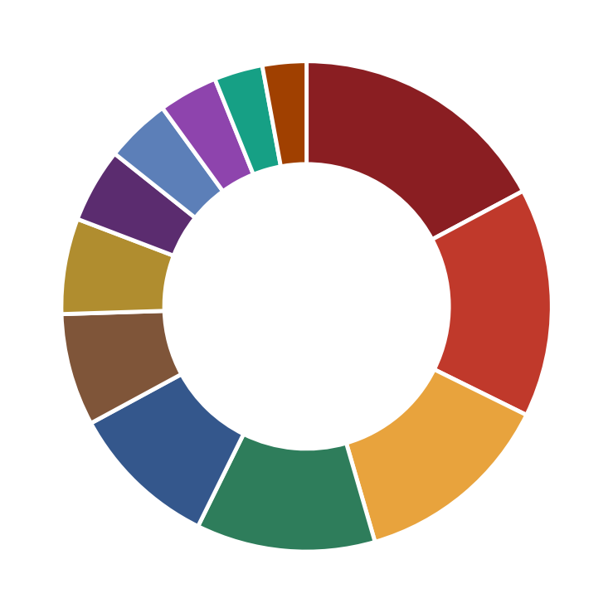
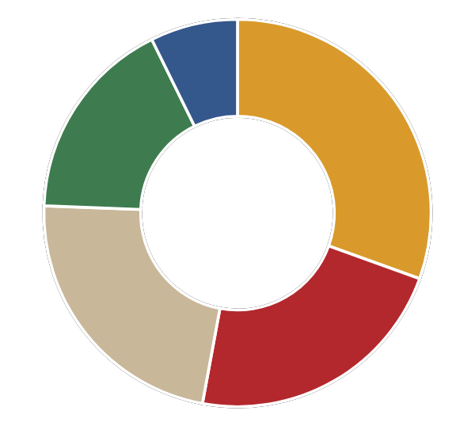
USE OF FUNDS — FOUNDATION SCHEME
SGD 364k · Explicit Sources & Uses
12 LINE ITEMS (BY VALUE) · AMOUNT · %
Working Capital - Bird Nest
SGD 63k · 17.2%
Employee Salaries 2026
SGD 55k · 15.1%
Nestsensials: OPEX & Working Capital
SGD 48k · 13.2%
SGD 364k
Total Funding
Swiftlet Houses: Initial RBW Construction (Setup)
SGD 43k · 11.8%
IoT Research Completion
SGD 36k · 9.8%
Working Capital - Equipment
SGD 27k · 7.4%
Export Lite: Working Capital
SGD 23k · 6.3%
Nestsensials: CAPEX (Machines + Renovation)
SGD 18k · 4.9%
Export Lite: NKV+HACCP Certification
SGD 16k · 4.3%
ERP System
SGD 14k · 3.9%
Audit Costs 2026-2028 & Other
SGD 12k · 3.2%
Export Lite: Washing-Line CapEx
SGD 11k · 2.9%
Foundation uses an explicit line-item Sources & Uses — incl. the Export Lite washing line, its NKV+HACCP certification (NKV: Indonesia's veterinary hygiene licence) and working capital — not the 3-bucket structure of Schemes B & C. Total = Rp5.09bn.

Slide 25
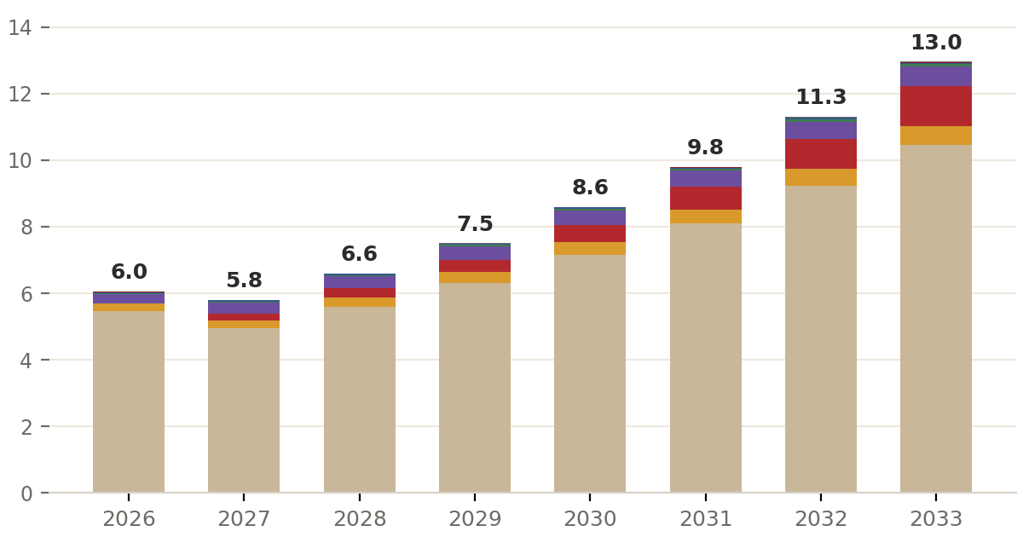
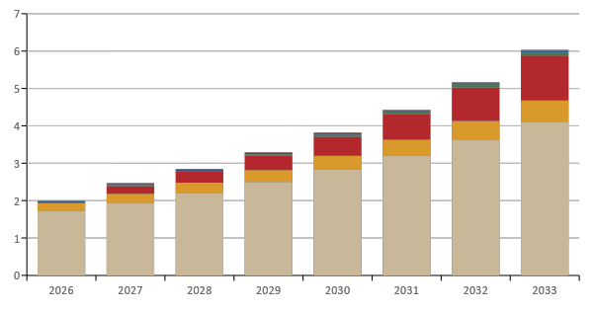

REVENUE PROJECTION — FOUNDATION SCHEME
Toward SGD 12.96m Revenue by 2033
SGD 6.05 → 12.96m
Total revenue, 2026 → 2033 · Rp181.51bn
±12% / year
Revenue CAGR 2026–2033
6% → 9%
Gross margin — mix shift to RTD, services & export
±33% / year
Nestsensials RTD growth — the margin engine
Raw Material (Trading)
Tools & Equipment
Nestsensials (RTD)
Export Lite + Washing Svc
Tech App
Consulting
Seminars
Swiftlet Houses (RBW)
Trading is the backbone of revenue; Nestsensials RTD, tech units and Export Lite lift gross margin from 6% to 9%.

Slide 26
EXECUTION ROADMAP — FOUNDATION SCHEME
Foundation Roadmap 2026–2033
PHASE 1 · 2026
PHASE 2 · 2027–2028
PHASE 3 · 2029–2033
Foundation
Activation
Compounding
Deploy SGD 364k: complete IoT research, ERP go-live, first RBW build, Nestsensials machines & the Export Lite washing line + certification
Trading & Export Lite generate SGD 6.05m revenue from day one — no revenue gap
Nestsensials RTD launches — SGD 214k revenue in 2027, gross-profit positive in its first selling year
RBW starts producing; app, consulting & washing service scale on the farmer base
Total revenue reaches SGD 12.96m; gross margin ±9%
Optional upgrade to Scheme B (add washing-factory capacity) stays open at any point
→
→
REVENUE
GROSS PROFIT
2026
SGD 6.05m
SGD 341k
2028
SGD 6.58m
SGD 487k
2030
SGD 8.59m
SGD 670k
2033
SGD 12.96m
SGD 1.14m
Milestone timing follows the Business Units model (revenue start years per unit). No full-factory or China-certification dependency in this scheme.

Slide 27

EXPORT EXECUTIVE SUMMARY
Build the Export Chain. Lead the Industry.
Funding schemes on offer:
Export Ready
EBN factory + China/SEA export · 12-ton capacity
SGD
1.07m
for 25% equity
Expansive
IPO-scale · multi-line GACC + consumer brand · 35 tons
SGD 2.97m
for 25% equity
B
C
What We Are Building
Why We Win
Offer Structure
An export-grade bird's-nest washing & processing factory — HACCP (food safety), NKV (Indonesia's veterinary hygiene licence), Halal, China GACC registration — a 16-stage production flow monitored by NestPro ERP.
Supply locked in from a network of 3,592 partner farmers & suppliers, end-to-end barcode traceability, and 33 training batches delivered with government agencies.
25% equity for fully funding the Year-1 cash need (Working Capital, CapEx, OpEx) — above the DCF fair share, so investors enter at a discount.

Slide 28



FINANCIAL FORECAST — SCHEME B
Export Ready — EBN Factory & China/SEA Export
INITIAL CAPITAL
DCF VALUATION (MEAN)
Scheme Logic
SGD 1.07m
SGD 5.01m
The Foundation scheme (supply-led: farmers, RBW, app, lite export) PLUS a full EBN washing factory & direct export.
Exporting to China & Southeast Asia unlocks far higher margins than selling raw material domestically.
A 12-ton annual capacity — large enough for export scale, prudent on capital needs.
Total Year-1 funding need: SGD 1.07m (Working Capital + CapEx + OpEx).
Rp15.02bn · 12-ton annual capacity
integrated DCF model output
FAIR SHARE
OFFERED
21.4%
25%
Funding ÷ DCF valuation
equity for investors
Investor discount: SGD 1.07m for 25% equity ≈ SGD 4.29m effective valuation — about 14% below the SGD 5.01m DCF value.

Slide 29
USE OF FUNDS — SCHEME B
Investor Fund Allocation
Working Capital (Year-1)
SGD 265k
24.7% · Raw-material purchases from the farmer network, operating cash buffer
SGD 1.07m
Total Funding
Year-1
Plant & Equipment / CapEx
SGD 446k
41.6% · Factory construction, washing & drying machines, ERP installation
Operational Expense (Year-1)
SGD 361k
33.7% · Worker salaries & training, certifications, utilities, overhead
Total funding = Use of Funds (identical to the Integrated Model KPI) — the three Year-1 cash buckets: Working Capital, Plant & Equipment / CapEx, Operational Expense.
5

Slide 30
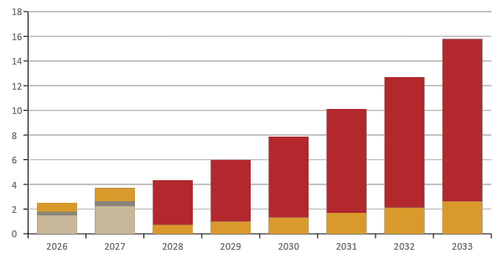
REVENUE PROJECTION — SCHEME B
Export Ready — Toward SGD 15.80m Revenue by 2033
SGD 2.51 → 15.80m
Total revenue, 2026 → 2033 · Rp221.14bn
±30% / year
Revenue CAGR 2026–2033
11% → 31%
Gross margin before vs after GACC (2028)
83% from GACC
Direct China export share of 2033 revenue
China OEM
Local Exporters
Non-China Export
China Export (GACC)
Capacity driver: raw washing 2,115 kg (2026) → 11,670 kg (2033) — reaching the 12-ton target as washing staff scale.

Slide 31
FINANCIAL FORECAST — SCHEME C
Expansive — IPO-Scale, Multi-Line GACC + Consumer Brand
INITIAL CAPITAL
DCF VALUATION (MEAN)
Scheme Logic
SGD 2.97m
SGD 15.66m
Full scale toward an IPO-ready company: multi-line GACC-registered production + our own consumer brand.
Head-to-head with incumbent leaders (Esta / RLCO) in the China market.
A 35-ton annual capacity — nearly 3x Scheme B; full leverage of the 3,592-farmer & supplier network.
Total Year-1 funding need: SGD 2.97m (Working Capital + CapEx + OpEx).
Rp41.65bn · 35-ton annual capacity
integrated DCF model output
FAIR SHARE
OFFERED
19.0%
25%
Funding ÷ DCF valuation
equity for investors
Investor discount: SGD 2.97m for 25% equity ≈ SGD 11.90m effective valuation — about 24% below the SGD 15.66m DCF value.
6

Slide 32
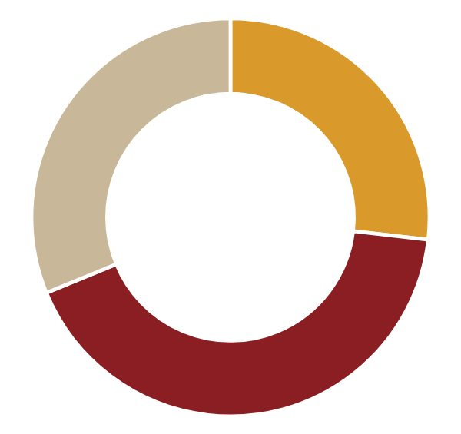
USE OF FUNDS — SCHEME C
Investor Fund Allocation · Expansive
Working Capital (Year-1)
SGD 796k
26.8% · Large-scale raw-material purchases (toward 35 tons), cash buffer
SGD 2.97m
Total Funding
Year-1
Plant & Equipment / CapEx
SGD 1.25m
42.0% · Multi-line GACC factory, high-capacity machines, brand infrastructure
Operational Expense (Year-1)
SGD 929k
31.2% · People & training, multi-line certifications, consumer-brand marketing
Total funding = Use of Funds (identical to the Integrated Model KPI) — the three Year-1 cash buckets: Working Capital, Plant & Equipment / CapEx, Operational Expense.
7

Slide 33
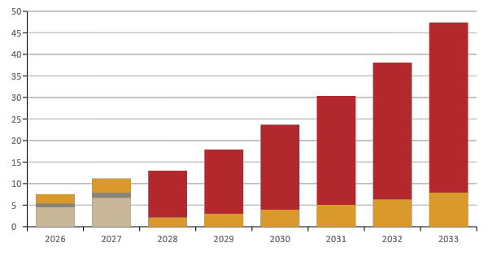
REVENUE PROJECTION — SCHEME C
Expansive — Toward SGD 47.39m Revenue by 2033
SGD 7.52 → 47.39m
Total revenue, 2026 → 2033 · Rp663.42bn
±30% / year
Revenue CAGR 2026–2033
11% → 31%
Gross margin before vs after GACC (2028)
83% from GACC
Direct China export share of 2033 revenue
China OEM
Local Exporters
Non-China Export
China Export (GACC)
Capacity driver: raw washing 6,345 kg (2026) → 35,010 kg (2033) — reaching the 35-ton target as washing staff scale.

Slide 34

REVENUE ROADMAP 2026–2033
From OEM to Direct GACC Export — Three Phases
PHASE 1 · 2026–2027
PHASE 2 · 2028
PHASE 3 · 2029–2033
Market Entry via Partner
GACC Unlock
Scale & Compounding
Entry channels: China OEM (product sold under a partner's brand), local exporters & non-China export
Cash flow from year one — while the factory & certifications are in progress
Gross margin ±11% (a volume phase, not a margin phase)
→
GACC registration granted → direct export to China begins
OEM & local-exporter channels wound down — all volume shifts to the high-margin lane
Gross margin jumps: ±11% → ±31%
→
GACC export becomes the main engine — ±83% of 2033 revenue
Revenue growth of ±30% per year
Full capacity reached: 12 tons (B) / 35 tons (C) by 2033
TOTAL REVENUE
2026
B SGD 2.51m
C SGD 7.52m
2028
B SGD 4.34m
C SGD 13.02m
2030
B SGD 7.89m
C SGD 23.66m
2033
B SGD 15.80m
C SGD 47.39m
8

Slide 35
PROJECT PLAN
Master Timeline: Q4 2026 — Q1 2028
STAGE
Q4 '26
Q1 '27
Q2 '27
Q3 '27
Q4 '27
Q1 '28
1
Planning & Engineering
2
Construction Phase I & Worker Recruitment
3
Construction Phase II & Factory Setup
4
Operational Readiness & Certification Submission
5
Certification & Export Readiness
6
Commercial Operation & First Export
≈ 15 months from planning to first export. Each stage is elaborated on the following slides — objective, key activities, and deliverables.
11

Slide 36
PROJECT STAGE 1 OF 6
Planning & Engineering
Q4 '26
Q1 '27
Q2 '27
Q3 '27
Q4 '27
Q1 '28
Objective Prepare every technical, financial, and legal aspect before factory construction begins.
Key Activities
Key Deliverables
Site feasibility study (candidates: Bangkalan · Surabaya · Mojokerto)
Factory layout & engineering design to HACCP standards
Business plan & CAPEX budget approval
Contractor selection & machine procurement planning
Initial permits (building & environmental)
✓ Feasibility Study completed
✓ Final factory layout & engineering drawings
✓ Business plan & CAPEX budget approved
✓ Project schedule locked
✓ Contractor selected
12

Slide 37
PROJECT STAGE 2 OF 6
Construction Phase I & Worker Recruitment
Q4 '26
Q1 '27
Q2 '27
Q3 '27
Q4 '27
Q1 '28
Objective Begin physical construction to the engineering design while recruiting & training the first wave of workers.
Key Activities
Key Deliverables
Site preparation, foundations & main building structure
Basic utilities: electricity, RO water, waste drainage
First-wave recruitment of feather-removal workers
Workforce training program — leveraging Markaswalet's 33 training batches
Finalise production-machine procurement contracts
✓ Main building structure erected
✓ Basic utilities installed & tested
✓ First batch of workers trained (ready to onboard)
✓ Recruitment SOP & training curriculum
✓ Production-machine POs issued
13

Slide 38
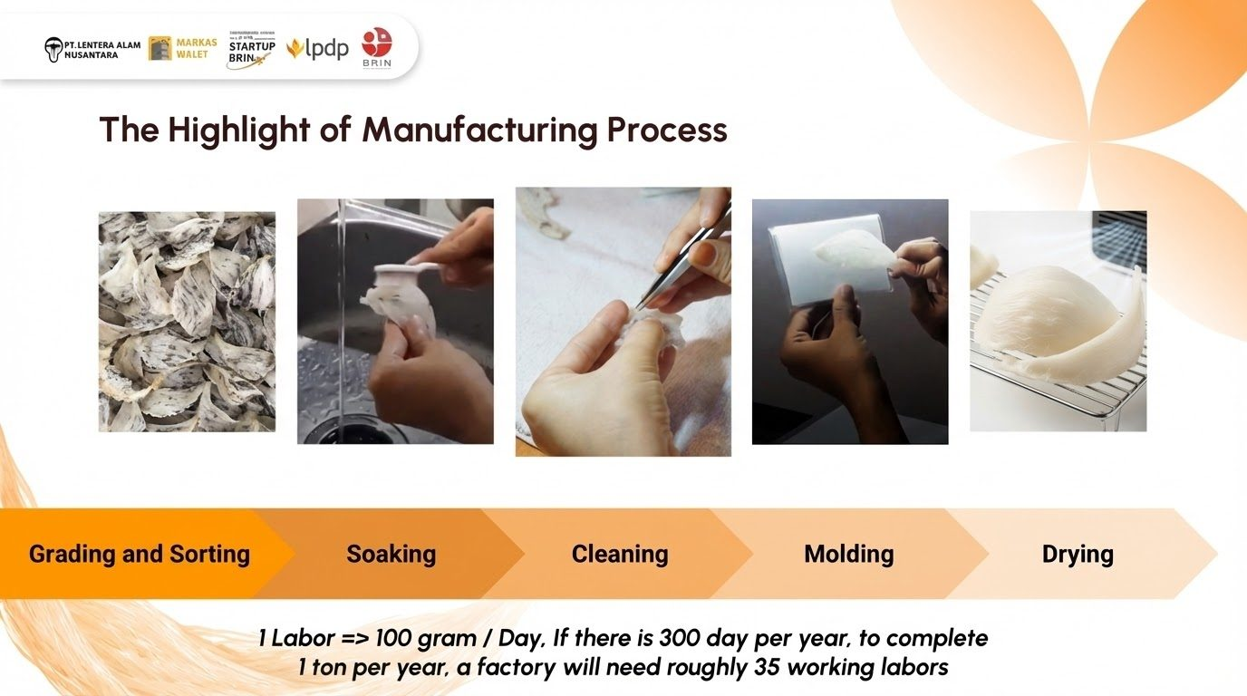

Slide 39
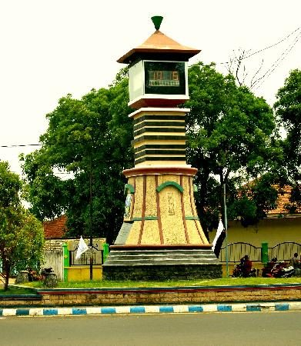
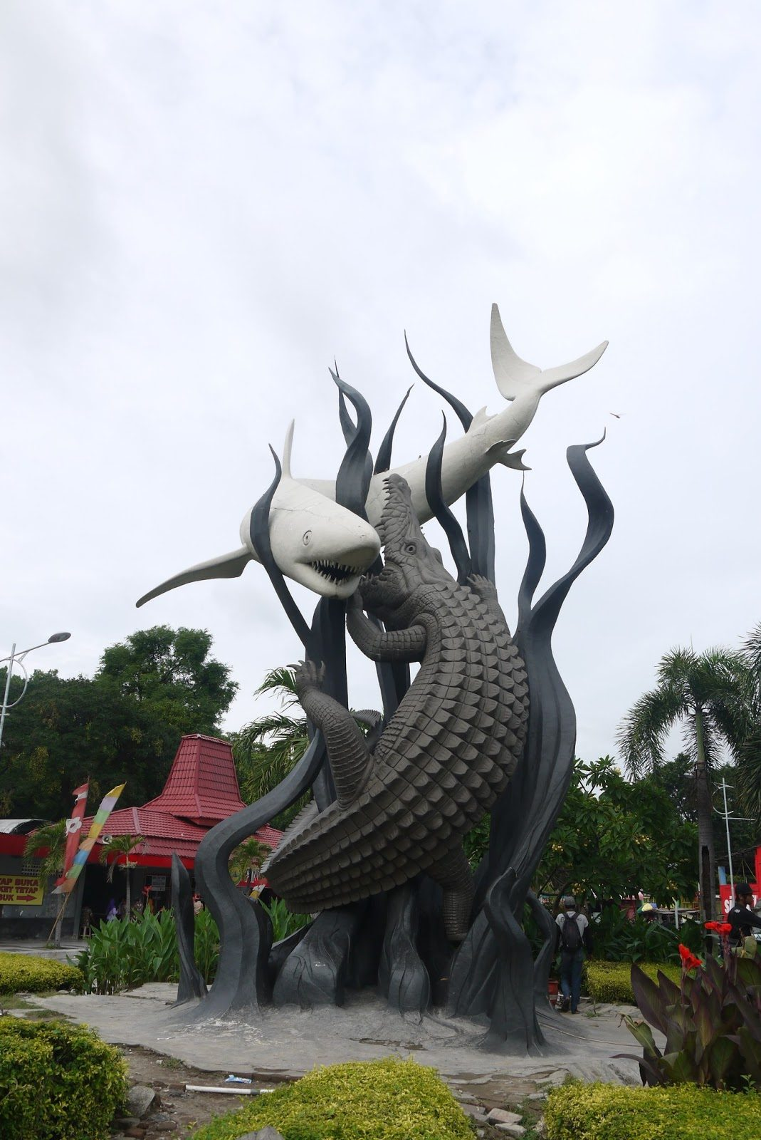
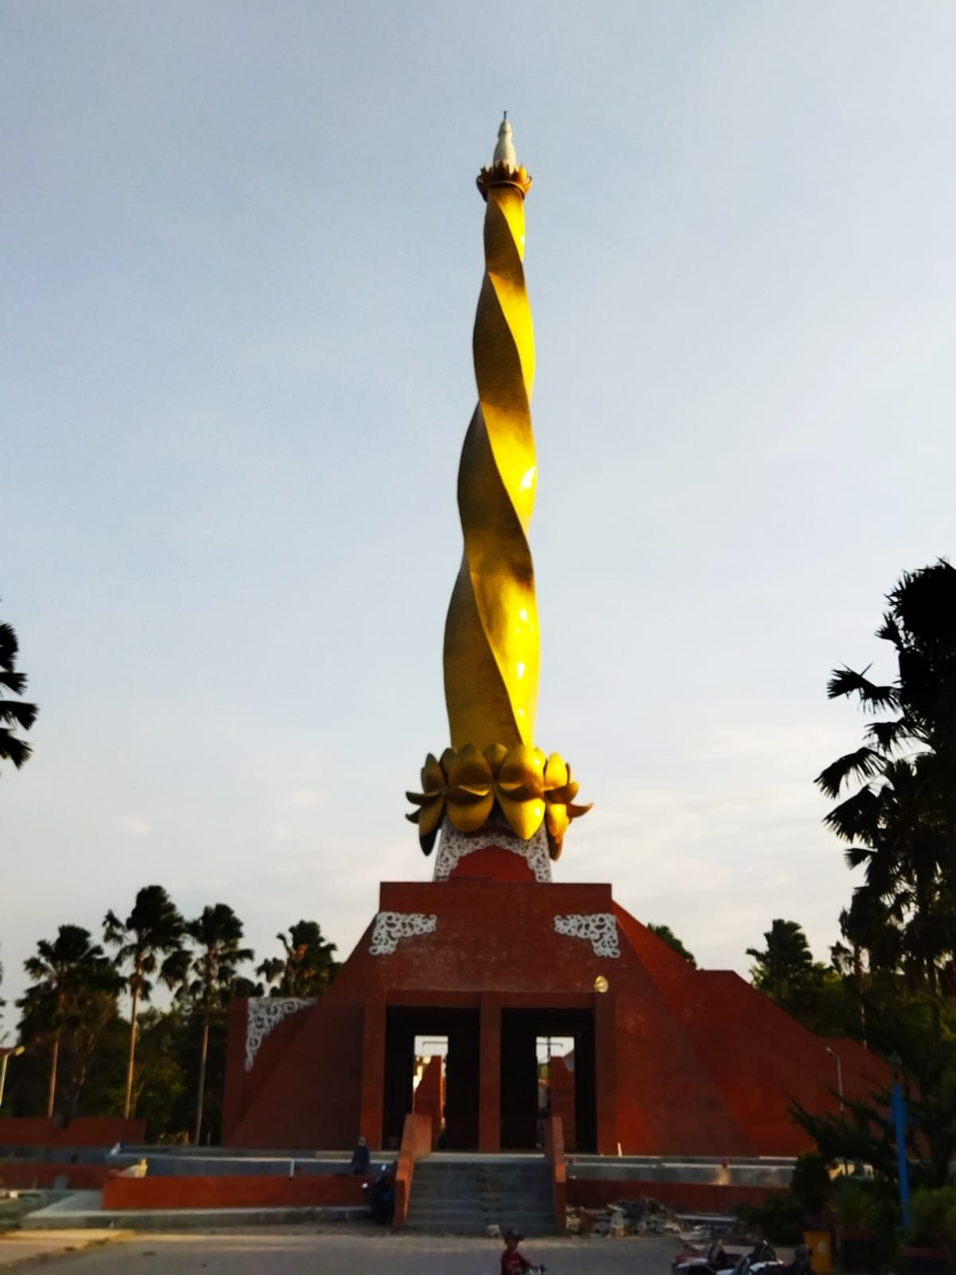
Project Stage: Planning & Engineering
Factory Overview - Location
Bangkalan
Surabaya
Mojokerto

Slide 40
PROJECT STAGE 1 · FACTORY OVERVIEW
Facility Requirements from the Financial Plan
SCHEME B · Export Ready
SCHEME C · EXPANSIVE
CapEx budget (Plant & Equipment)
SGD 446k
CapEx budget (Plant & Equipment)
SGD 1.25m
Raw washing capacity
2,115 kg (2026) → 11,670 kg (2033)
Raw washing capacity
6,345 kg (2026) → 35,010 kg (2033)
Washing workers needed
±70 (2026) → ±390 (full capacity)
Washing workers needed
±210 (2026) → ±1,170 (full capacity)
Building strategy
Renovate / build lean on low-cost land — CapEx focused on machines & the clean room
Building strategy
Multi-line GACC facility — needs large land & a big labour pool from day one
Worker-count basis: 1 worker ≈ 100 grams/day × 300 working days/year (main-deck assumption) → raw capacity ÷ 30 kg. Nest washing is labour-intensive — the site must offer a large labour pool.

Slide 41
PROJECT STAGE 1 · FACTORY OVERVIEW
Location — Bangkalan · Surabaya · Mojokerto
Criteria | Bangkalan | Surabaya | Mojokerto
Land & construction cost | Low — ample land, most CapEx-efficient | High — absorbs the largest CapEx share | Medium — growing industrial zone
Labour-intensive workforce (±390 to ±1,170 workers) | Large pool, competitive wages — via Suramadu | Large pool, but the highest minimum wage | Trained industrial pool, mid-level wages
Export access (Tanjung Perak / Juanda) | ±45 min via the Suramadu Bridge | Closest — in the port city | ±1–1.5 h via toll road
Raw-material access (farmers in Kalimantan/Sulawesi/Sumatra) | Near — inbound via Surabaya port | Closest to the logistics entry point | Needs a feeder from Surabaya
Scheme fit | A & B — lowest opex, fits large-scale labour-intensive work | Export hub / QC / office — not mass production | Strong alternative for both A & B
Early indication: Bangkalan leads for labour-intensive production on a limited CapEx; Surabaya is optimal as the export hub. The final decision is made through the Stage 1 Feasibility Study (Q4 2026).

Slide 42
PROJECT STAGE 3 OF 6
Construction Phase II & Factory Setup
Q4 '26
Q1 '27
Q2 '27
Q3 '27
Q4 '27
Q1 '28
Objective Complete construction, install machines, and lay out production to export food-hygiene standards.
Key Activities
Key Deliverables
Food-grade interior finishing & production clean room
Install washing, drying & sterilisation machines
Lay out the 16-stage flow (soaking → final packaging)
Install NestPro ERP + barcode traceability system
Commissioning & functional tests of every line
✓ Factory construction 100% complete
✓ Machines installed & commissioned
✓ HACCP-compliant production layout
✓ NestPro ERP live on the production floor
✓ Barcode traceability active end-to-end
14

Slide 43
PROJECT STAGE 1 · FACTORY OVERVIEW
Ideal Factory Land Specifications
SCHEME B · 12 TONS
SCHEME C · 35 TONS
±3,000 m² minimum land
±10,000 m² minimum land
±1,800 m² building area · 1–2 floors · ±390 workers
±5,000 m² building area · multi-line complex · ±1,170 workers
(±2–2.5 m²/worker washing area + support zones)
(1 ha — a mid-scale industrial footprint)
Building-area composition (indicative):
55%
20%
10%
10%
5%
■ 16-stage production (dirty → clean) ■ Warehouse & cold storage ■ QC lab & office ■ Worker facilities ■ Circulation
Mandatory land criteria:
✓ Industrial zoning · clean SHM/HGB land title
✓ Flood-free, stable ground (machine & water-tank loads)
✓ 40-ft container-truck access — road width ≥ 8 m
✓ ±30% expansion space for capacity scale-up
✓ 3-phase power (A ±150 kVA · B ±500 kVA) + backup genset
✓ Large water source + RO installation for washing
✓ Wastewater-treatment (IPAL) area for organic effluent
✓ One-way dirty → clean layout (an HACCP / NKV requirement)

Slide 44
PROJECT STAGE 4 OF 6
Operational Readiness & Certification Submission
Q4 '26
Q1 '27
Q2 '27
Q3 '27
Q4 '27
Q1 '28
Objective Run trial production, stabilise quality & shrinkage, then file all export certifications.
Key Activities
Key Deliverables
Trial production runs & per-batch shrinkage calibration
Advanced training & worker competency certification
Complete SOP documentation (audit-ready)
File NKV, HACCP & Halal certifications
Initiate GACC registration for China market access
✓ Trial batches pass internal QC standards
✓ Shrinkage controlled & monitored real-time in the ERP
✓ Certification dossiers fully submitted
✓ SOPs & traceability audit-ready
✓ GACC registration file in progress
15

Slide 45
PROJECT STAGE 4–5 · CERTIFICATIONS
Certification Map: The Foundation for GACC Export
NKV
HACCP
HALAL
GACC
Hygiene & Sanitation
Food Safety
Halal Assurance
China Export Registration
Provincial Veterinary Authority
(Permentan 11/2020)
Certification body
accredited by KAN
BPJPH · audit LPH
· MUI fatwa
General Administration
of Customs China
→
→
→
Mandatory baseline for animal-product businesses — prerequisite for export & GACC registration
Hazard control across the 16 production stages — required by international buyers
Access to Muslim markets & modern retail — added value in export markets
The margin key: direct China export — the 2028 revenue inflection point
File Q3 '27
File Q3 '27
File Q3 '27
Granted 2028
Strategic sequence: NKV & HACCP are technical prerequisites for GACC registration — all three are filed in parallel in Stage 4 (Q3–Q4 2027) so GACC is granted in time to open direct China export in 2028.

Slide 46
CERTIFICATION 1 OF 4 · STAGE 4–5
NKV — Veterinary Control Number
What & Who
Why It Matters for MARKASWALET
What: Hygiene & sanitation compliance certificate for animal-product businesses — including bird's-nest processing.
Issuer: Provincial Veterinary Authority / Livestock Office (basis: Regulation Permentan No. 11/2020).
Validity: 5 years with periodic surveillance; the audit result sets Level A / B / C.
An absolute prerequisite for export & GACC registration — without NKV, the China lane is closed
The NKV level determines which export destinations are accessible
The factory is designed to NKV hygiene-sanitation standards from Stage 1
Process Flow:
1
2
3
4
5
6
Application via OSS / Provincial Office + complete business documents
Document review (permits, hygiene SOPs, flow layout)
On-site audit by NKV auditors — building, flow, sanitation
Corrective actions (CAPA) by the factory team
Level determination & NKV certificate issuance
Periodic surveillance to maintain the level
Target: file Q3 2027 (Stage 4) → granted Q4 2027 (Stage 5). A high NKV level strengthens the GACC registration.

Slide 47
CERTIFICATION 2 OF 4 · STAGE 4–5
HACCP — Hazard Analysis Critical Control Point
What & Who
Why It Matters for MARKASWALET
What: A food-safety management system: hazard identification & critical control points (CCPs) across the entire production flow.
Certification: KAN-accredited certification body (reference: SNI CAC/RCP 1).
Typical nest CCPs: Post-wash nitrite level, drying moisture content, physical/foreign-object contamination.
A mandatory standard for international buyers & a technical GACC prerequisite
Protects the 16 production stages from rejection / recall risk in destination markets
CCP monitoring integrated with NestPro ERP — real-time, audit-ready data
Process Flow:
1
2
3
4
5
6
Form the HACCP team, product description & intended use
Build & verify the 16-stage process flow diagram
Hazard analysis & determination of CCPs
Set critical limits, monitoring & corrective actions
Implement + document (the 7 HACCP principles) on the floor
Two-stage certification audit → certificate + annual surveillance
Target: implementation from the trial run (Q3 2027) → certificate Q4 2027. Digital documentation via NestPro ERP speeds up the audit.

Slide 48
CERTIFICATION 3 OF 4 · STAGE 4–5
Halal Certificate — BPJPH
What & Who
Why It Matters for MARKASWALET
What: Halal product assurance under Law No. 33/2014 (JPH) — covering materials, process, facilities, and the halal supervisor.
Institutional flow: Register with BPJPH → inspection by an LPH → MUI fatwa → certificate issued by BPJPH.
Validity: Valid as long as materials / processes are unchanged (the SJPH must be maintained).
Opens the domestic Muslim market & strengthens export-market trust
An entry requirement for modern retail & marketplaces for consumer products
Aligned with the consumer-brand plan in the Expansive scheme (C)
Process Flow:
1
2
3
4
5
6
Set up the Halal Assurance System (SJPH) & appoint a halal supervisor
Online registration via SIHALAL (BPJPH) + complete documents
Audit by the LPH — materials, production process & facilities
Halal ruling session by the MUI Fatwa Commission
Halal certificate issued by BPJPH
Maintain the SJPH & report any changes
Target: filed in parallel with NKV & HACCP in Q3 2027. Bird's nest is a single-ingredient product — low halal risk.

Slide 49
CERTIFICATION 4 OF 4 · THE CHINA EXPORT KEY
GACC — China Export Registration
What & Who
Why It Matters for MARKASWALET
What: Mandatory registration of foreign food producers with GACC (Decrees 248/249) — for bird's nest, under the Indonesia–China bilateral protocol.
Pathway: Via Indonesia's competent authority (Quarantine Agency) → registered in GACC's CIFER system.
Key technical requirements: Nitrite ≤ 30 ppm, protocol-compliant heat treatment, full traceability from registered swiftlet houses.
Opens the biggest channel: GACC export = ±83% of 2033 revenue (both export schemes)
The margin inflection point: gross margin jumps ±11% → ±31% once granted (2028)
Barcode traceability + Markaswalet's registered RBW network = an audit advantage
Process Flow:
1
2
3
4
5
6
Meet domestic prerequisites: NKV, HACCP & registered source swiftlet houses
Application & eligibility assessment by the Quarantine Agency (competent authority)
Readiness audit: traceability, nitrite control, heat treatment, hygiene
Authority recommendation → company registration via the CIFER system
GACC review — document checks & possible inspection (video/on-site)
GACC registration number granted → first export + ongoing monitoring
An estimated 12–18-month process — initiated from Q3 2027 (Stage 4) so it is granted in 2028, in line with Phase 2 of the revenue roadmap.

Slide 50
PROJECT STAGE 5 OF 6
Certification & Export Readiness
Q4 '26
Q1 '27
Q2 '27
Q3 '27
Q4 '27
Q1 '28
Objective Obtain official certifications and complete all commercial readiness for the first export.
Key Activities
Key Deliverables
NKV / HACCP / Halal field audits & follow-up on findings
Finalise GACC (China) registration approval
Sign China / Southeast Asia buyer contracts
Prepare export logistics, packaging & customs documents
Raw-material stock from the 3,592-farmer network
✓ NKV, HACCP & Halal certificates issued
✓ GACC registration number obtained
✓ Export buyer contracts / LOIs locked
✓ Logistics lane & forwarder ready
✓ Raw-material stock secured for the first export batch
16

Slide 51
PROJECT STAGE 6 OF 6
Commercial Operation & First Export
Q4 '26
Q1 '27
Q2 '27
Q3 '27
Q4 '27
Q1 '28
Objective Begin full commercial production and deliver the first export shipment.
Key Activities
Key Deliverables
Ramp production toward full capacity (12 tons — Scheme B; stepwise to 35 tons — Scheme C)
Execute the first export shipment to China
Monitor production, shrinkage & quality KPIs via NestPro ERP
Post-export review & capacity-scaling plan
Regular investor reporting
✓ First export shipment delivered
✓ First commercial revenue booked
✓ First-quarter operations KPI report
✓ Pipeline of follow-on export orders
✓ Year-2 scaling plan agreed
17

Slide 52

Metric | Value
IPO Date | Dec 8, 2025
IPO Shares Offered | 625 million shares (20% of total equity)
IPO Price per Share | IDR 168
Total Shares Post-IPO | 3.125 billion shares
Post-IPO Market Cap | IDR 625 billion
Book Value (Dec 2025) | IDR 112 billion
Price-to-Book (P/B) Ratio | 4.9x
Revenue (2024) | IDR 400 billion
Net Profit (2024) | IDR 19 billion
Net Profit Margin | ~4.7%
Strategic Benchmark: IPO Performance of PT Abadi Lestari Indonesia Tbk (RLCO)
1. Exporter and manufacturer of Edible bird nest (20,6 Tones / Year)
2. Market leader on ready to drink bird nest brand who targeting Indonesian consumers, having 800k followers on social media
3. Their 95% of raw materials sourcing come from farmer suppliers (external sourcing)

Slide 53
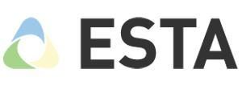
Metric | Value
IPO Date | Aug 8, 2024
IPO Shares Offered | 822.5 million shares (20% of total equity)
IPO Price per Share | IDR 200
Total Shares Post-IPO | 4.1125 billion shares
Post-IPO Market Cap | IDR 822.5 billion
Book Value (Dec 2023) | IDR 188.99 billion
Price-to-Book (P/B) Ratio | 4.35x
Revenue (2024) | IDR 541.2 billion
Net Profit (2024) | IDR 27.1 billion
Net Profit Margin | ~5.0%
EPS (2024) | IDR 6.58/share
Strategic Benchmark: IPO Performance of PT Esta Indonesia (NEST)
1. Exporter and manufacturer of Edible birdnest (28,5 Tones / year)
2. Their 40% of raw materials sourcing come from their own bird nest house (internal sourcing)

Slide 54
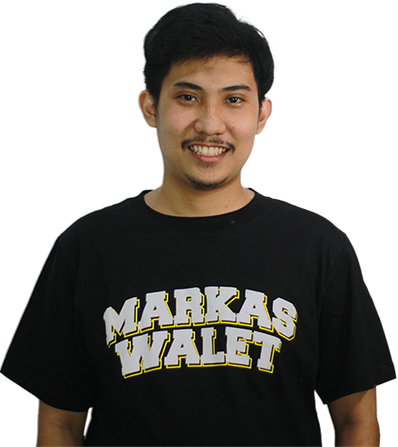

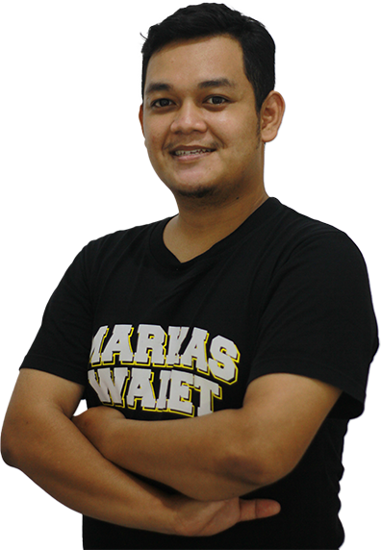
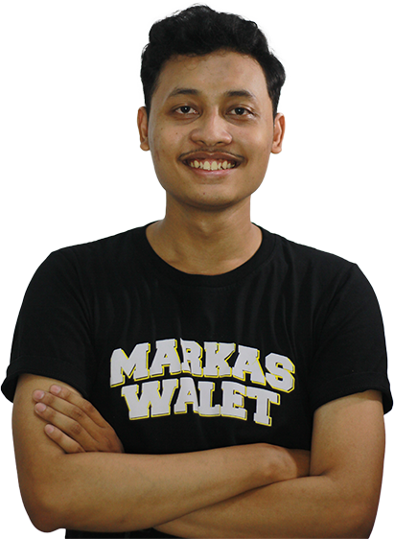
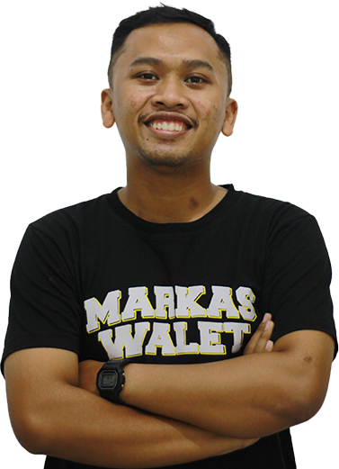
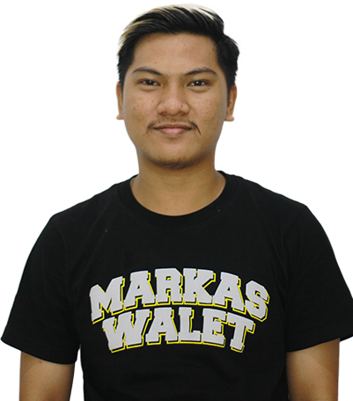
CEO
M Fairuzzuddin Zuhair, S.Si, MBA
Bachelor of Mathematical Science
Airlangga University
MBA, Nanyang Technological University
Focus on Business, Innovation,
and Tech Adoption
Our Team
CDO
Moch Alifudin F, S.Hum
Bachelor of Arts
Airlangga University
Focus on Branding and Design
CMO
M Haqqi Hudan M, S.M
Bachelor of Management Marketing
Universitas Brawijaya
Focus on Brand Marketing & Digital Marketing
CFO
M Taufiqul Yakin, S.M, Msc
Bachelor of Accounting
Airlangga University
Master of Accounting Management, University of Indonesia
Focus on Financial Projection and Audit Internal
CBD
Maulana Satria Aji, S.Km
Bachelor of Public Health
Airlangga University
Focus on Business Development and CRM
CPD
Dany Ali Syafii, S.Ant.
Bachelor of Anthropology
Airlangga University
Focus on Product Development

Slide 55
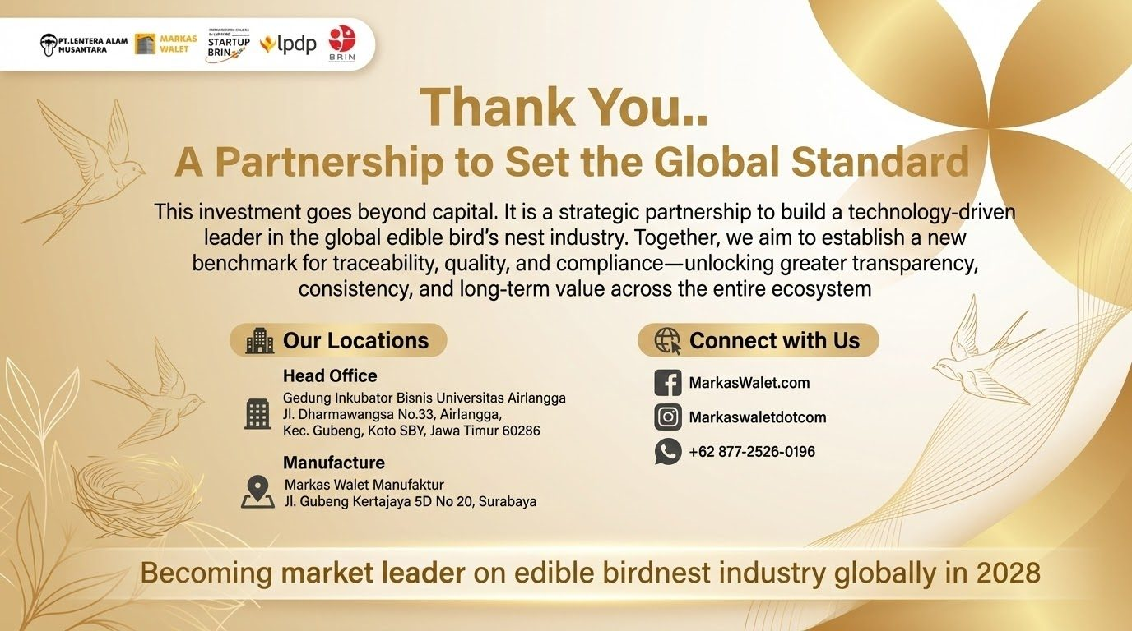

Slide 56
Appendix
Markaswalet x LPDP Collaboration
“Government Collaboration”

Slide 57




Project Positioning
Tech Ecosystem Markaswalet
Population Counting Technology
Manufacturing ERP
Markas walet
Traceability System
Swiftlet Farmer Education Application

Slide 58
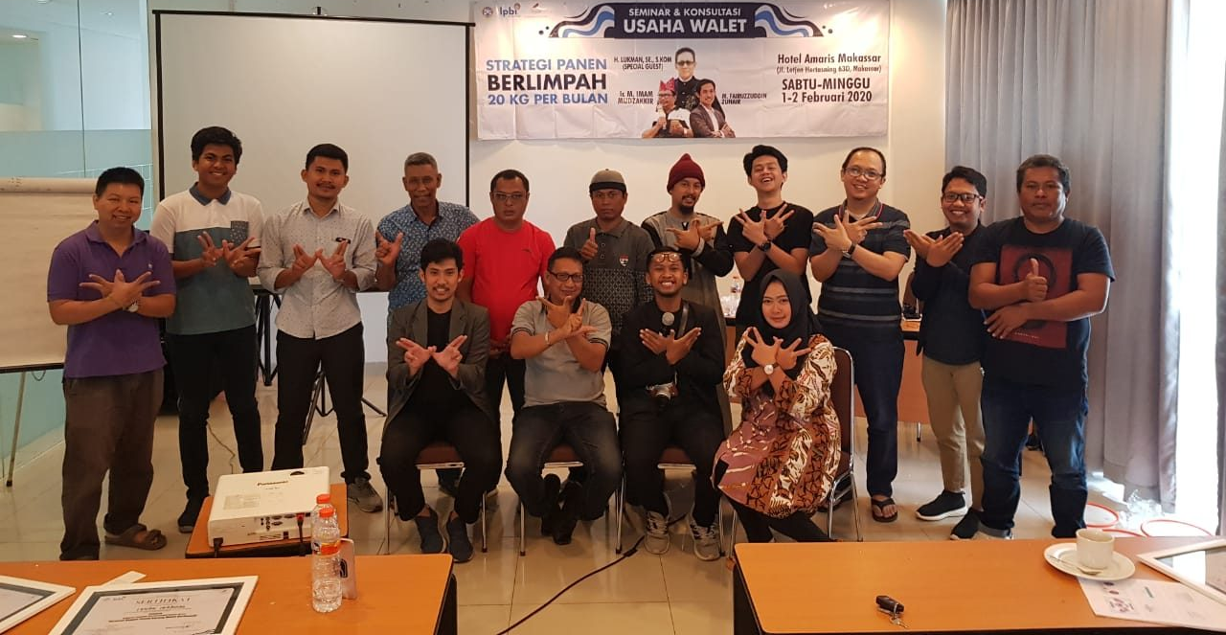
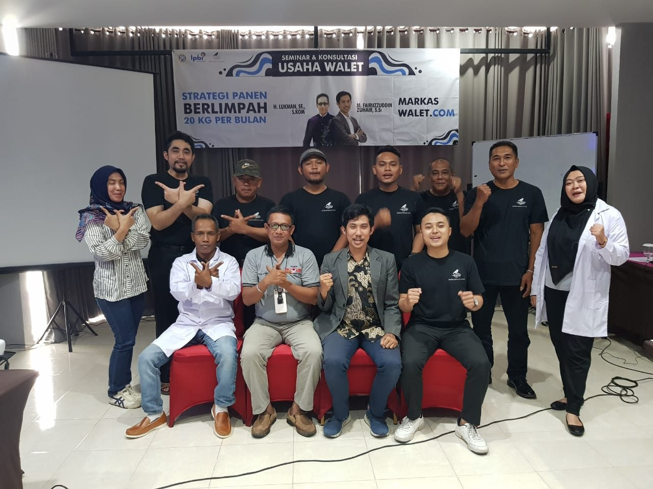
Our Strength at Edu-Agritech
BirdNest Farmer Data Acquisition in Markas Walet
3100 Bird Nest Farmer User Apps
1
3592 Farmer and Supplier
2
23500 Bird Nest Farmer in All Platform Markas Walet
3

Slide 59
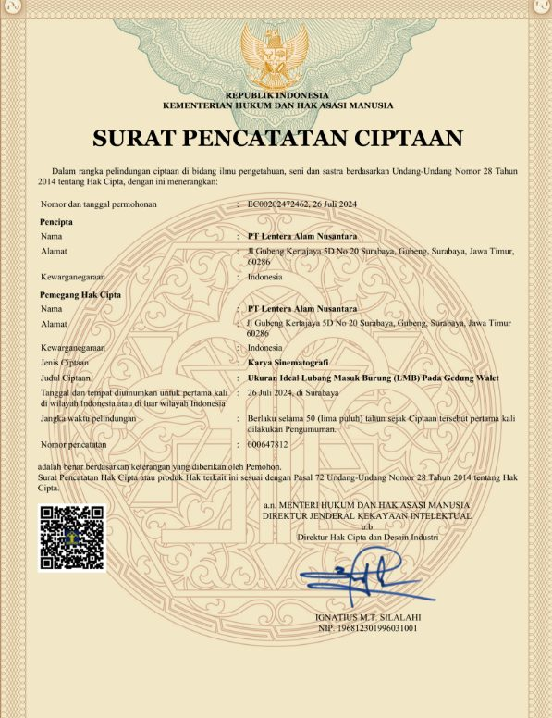
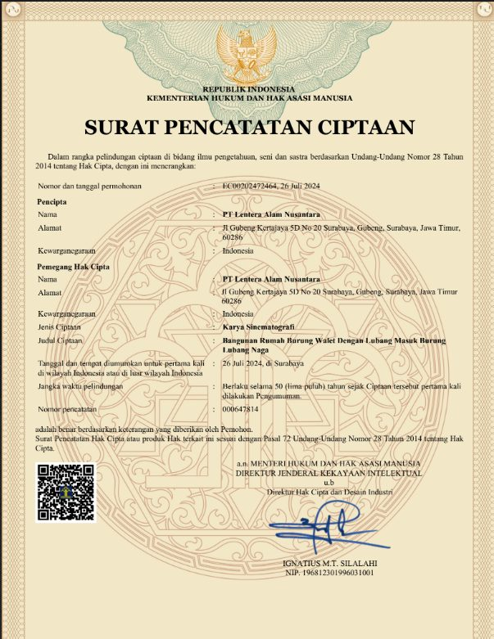
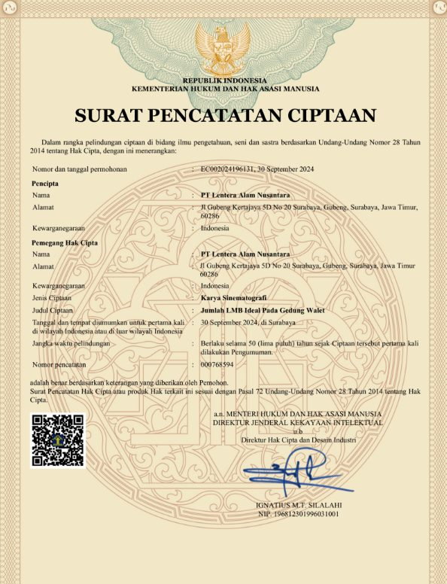
Intellectual Property & Legal Affairs
2
24
PATENT
COPY-
RIGHTS
1
3
INDUSTRY
DESIGN
BRAND PATENTS

Slide 60
Opportunity Cost (if not partnering with Markas Walet)
LOST EXPORT POTENTIAL
LOST JOB CREATION
LOST INNOVATION SHOWCASE
LOST GLOBAL POSITIONING
LOST SGD IMPACT
80% of global supply but only 49 active exporters; 500+ MSMEs miss export access → loss of foreign exchange.
1 ton/month = 400–500 workers creation; missed opportunity to boost local employment.
No national model for AI-based traceability & clean manufacturing (HACCP/NKV).
Competitors like Malaysia & Vietnam gain dominance in China market.
Missed progress on SDG 8 (Jobs), 9 (Innovation), 15 (Life on Land).
💡
Partnering with Markas Walet = stronger exports, local jobs, innovation leadership, and national branding for Indonesia’s agritech sector.

Slide 61
Government Relation

Slide 62
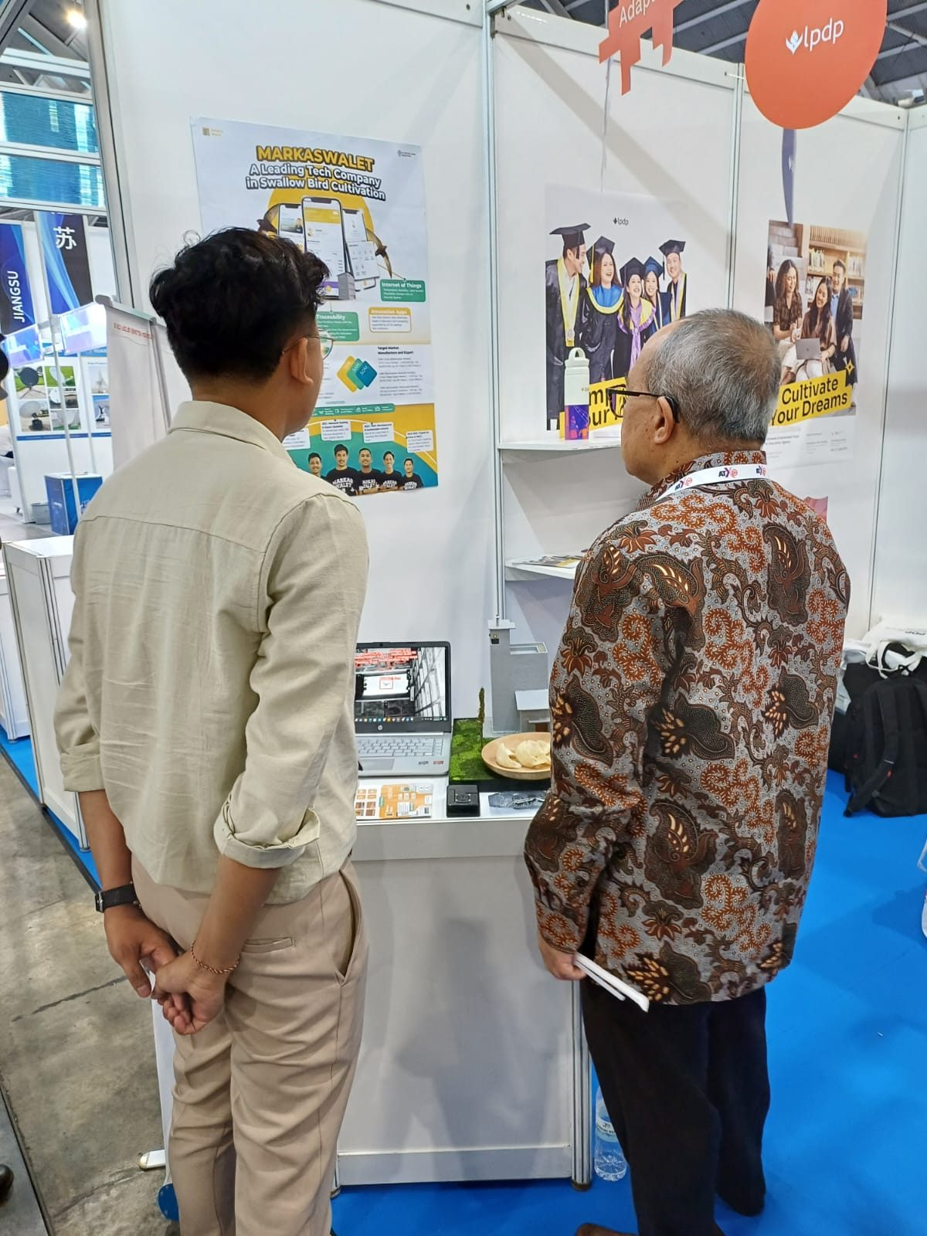
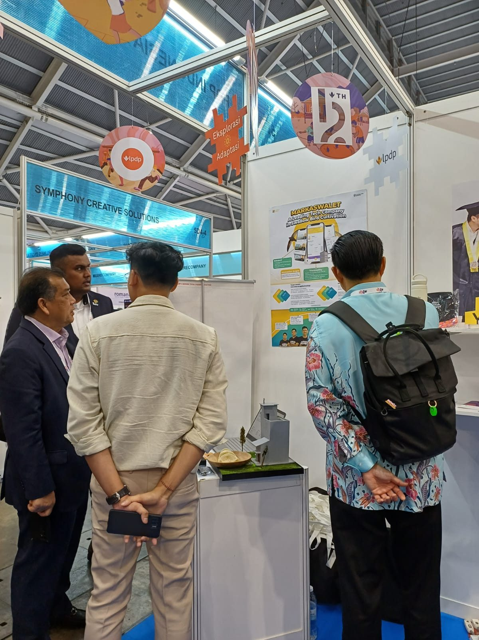
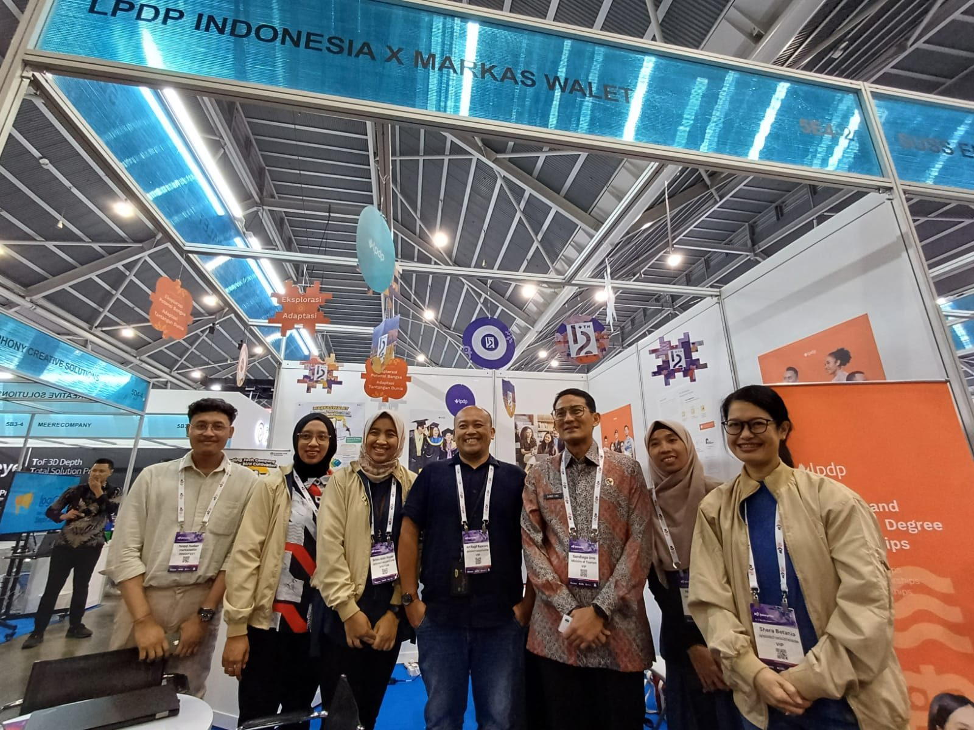
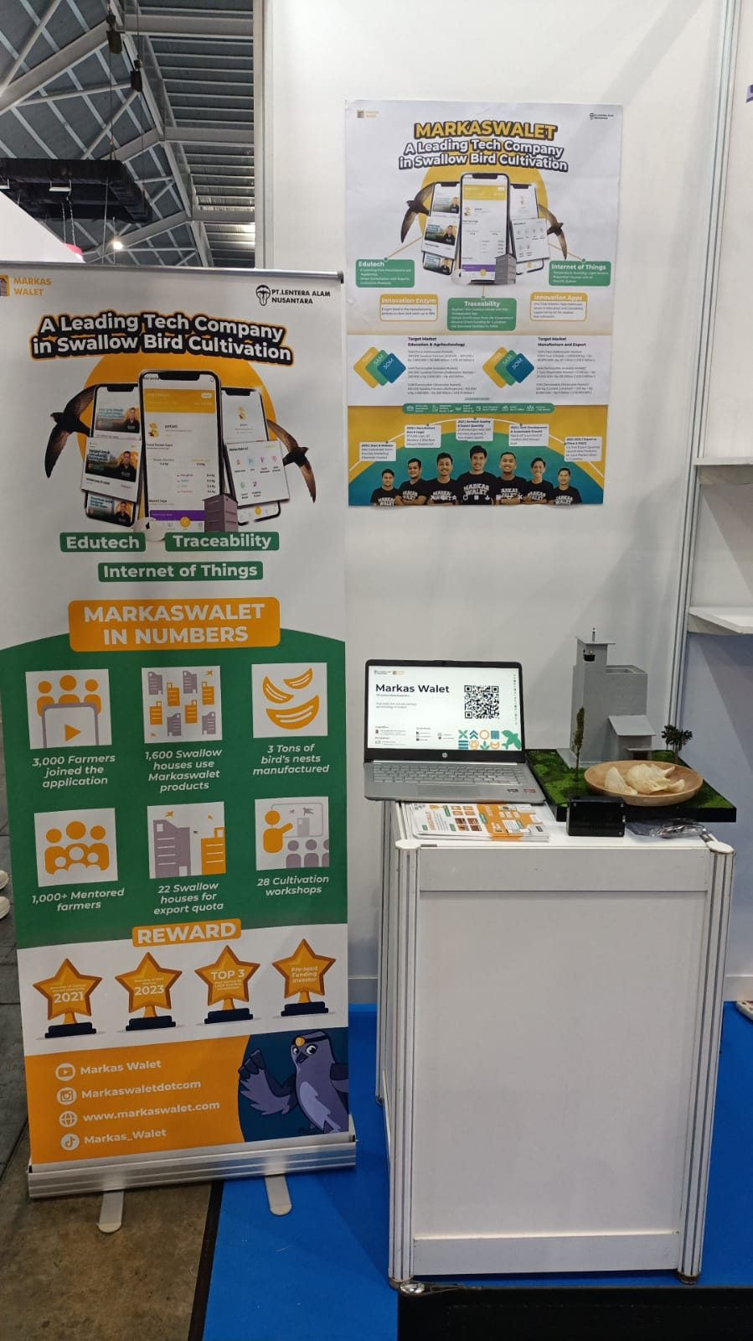
PPBR Program Implementation
Markaswalet X LPDP : Innovfest Singapore

Slide 63
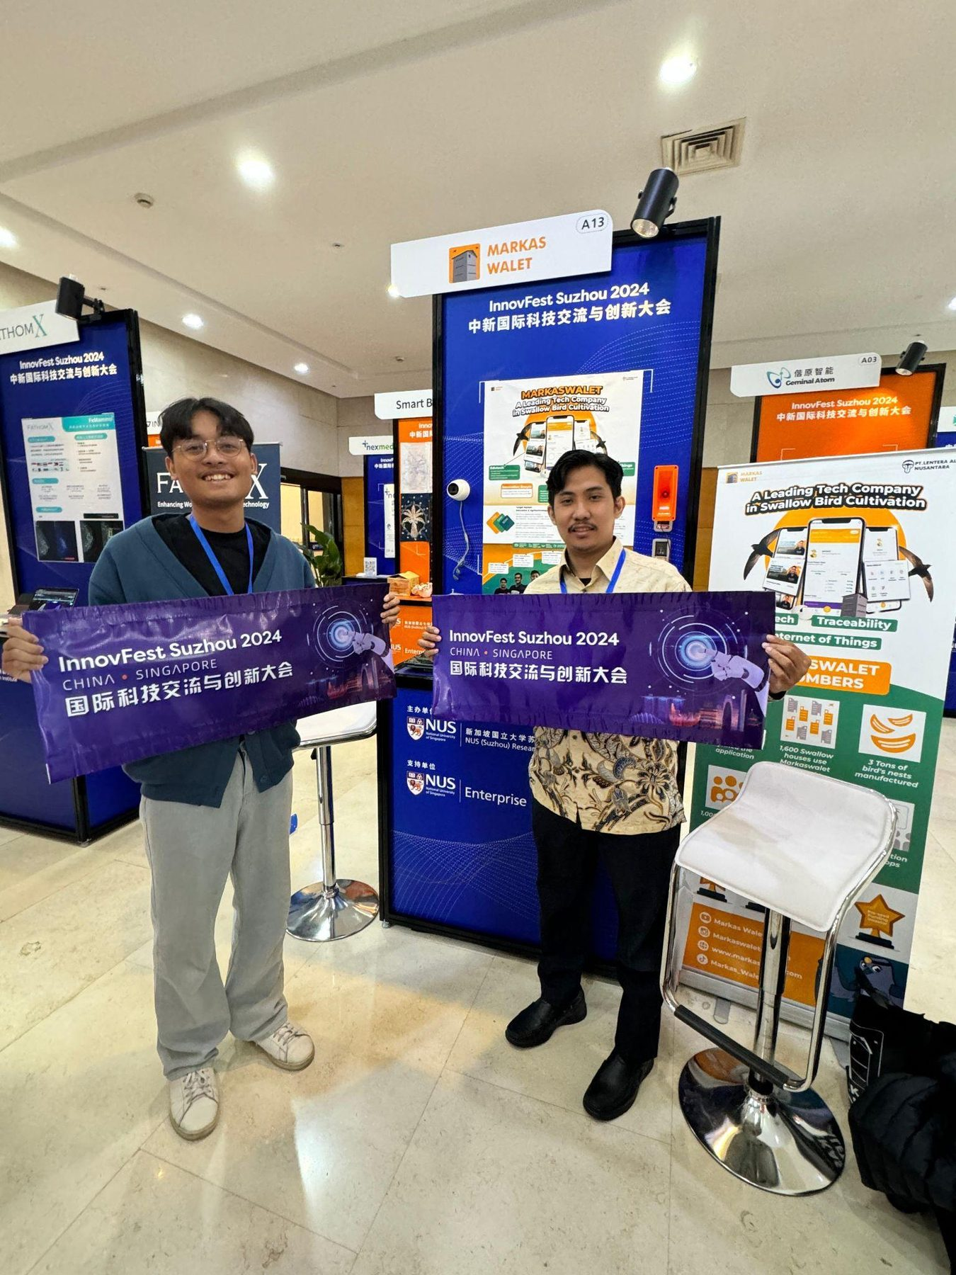
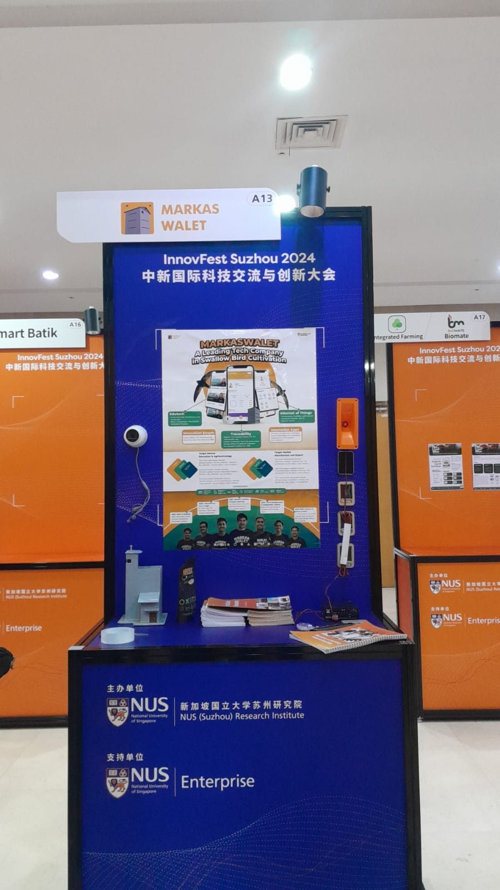
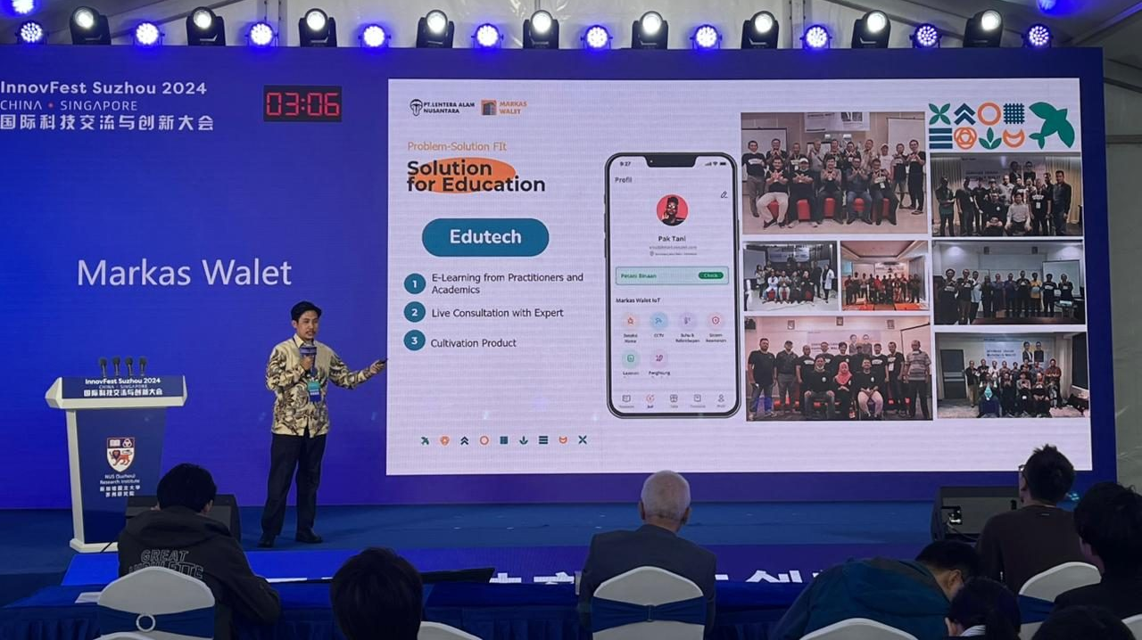
PPBR Program Implementation
Markaswalet X LPDP : Innovfest China

Slide 64











Experience
33 Training Batches
List of Seminars Organized by Markaswalet
Makassar 2020, 2021, 2022, 2023, 2024
Banjarmasin, 2021, 2022, 2022, 2023, 2024
Palembang 2021, 2022, 2023
Padang 2021, 2022
Samarinda 2021, 2022, 2024
Palangkaraya 2021, 2022, 2024
Palu, 2021, 2022
Pekanbaru 2021, 2022
Jambi 2021
Tanah tidung 2021
Lombok 2020
Pontianak 2020
Balikpanan 2020

Slide 65


PPBR Program Implementation
Swiftlet Farming Seminar in Banjarmasin with the South Kalimantan Balai Karantina Pertanian

Slide 66

PPBR Program Implementation
In-House Training with Barantan Makassar and Markaswalet

Slide 67



PPBR Program Implementation
Training of Birdnest Production Increasing with Dinas Petanian Kab. Bulungan Kalimantan Utara

Slide 68


PPBR Program Implementation
Training of Swiftlet Cultivation with Dinas Pertanian Kab. Tana Tidung Kalimantan Utara

Slide 69


PPBR Program Implementation
Forum Group Discussion in Makassar with the South Sulawesi Balai Karantina Pertanian

Slide 70


PPBR Program Implementation
Forum Group Discussion with the East Kalimantan Dinas Peternakan & Kesehatan Hewan

Slide 71


PPBR Program Implementation
Training of Trainers (2024) with Swiftlet Farmers under the East Kalimantan Farming Government Agency

Slide 72


PPBR Program Implementation
Training of Trainers with East Kalimantan Government Agency of Farming 2025

Slide 73



PPBR Program Implementation
Training of Trainers dengan Dinas Pertanian Kab. Banjar Kalimantan Selatan 2025

